Slide 1

A Darkening Horizon:
Nuclear Challenges Around the World
Managing the Atom Project
Matthew Bunn
James R. Schlesinger Professor of the Practice of Energy, National Security, and Foreign Policy, Harvard Kennedy School
Global Santa Fe
6 December 2023
belfercenter.org/managingtheatom

Slide 2
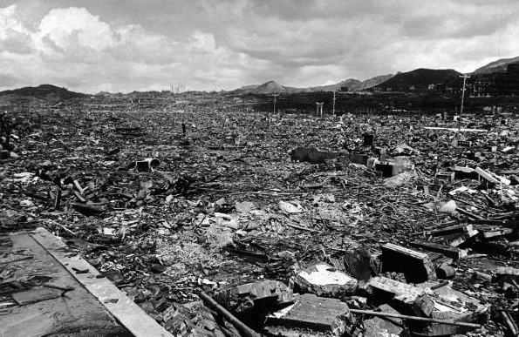
Effect of a single nuclear weapon
Source: Time-Life

Slide 3
The nuclear horizon has darkened in the last 10 years
Radically increased U.S.-Russian and U.S.-Chinese hostility
  Dramatic worsening from the war in Ukraine
  Repeated Russian nuclear threats
Large expansion of Chinese nuclear forces underway
  U.S. considering nuclear buildup to cope with “two nuclear peer” threat
Major advances in evolving technologies that complicate nuclear balances – missile defenses, AI, cyber, counter-space, more…
Substantially increased doubts over U.S. leadership
  Increased anxieties among U.S. allies
Arms control + risk reduction measures greatly weakened
  INF Treaty, U.S. + Russian participation in Open Skies treaty gone
  Almost all U.S.-Russian gov-gov communication cut off, much U.S.-Chinese gov-gov communication
  New START expires 2/26, little prospect for replacement in treaty form

Slide 4
The nuclear horizon has darkened in the last 10 years (II)
Major expansion in North Korean nuclear + missile arsenal
Dramatic increase in Iranian nuclear capabilities (and expanded missile force, ongoing support for armed groups)
Ongoing arms competition in South Asia
Ongoing nuclear terrorist threats
  Reduced capabilities of global terrorist groups (al Qaeda, Islamic State)
  Expanded insider threats from violent domestic extremists in many countries
  Reduced global focus on the danger – nuclear security summits long over
Increased tensions between nuclear haves and have-nots
  Symbolized by the nuclear weapons ban treaty, now in force
  Makes nonproliferation progress more difficult
Ongoing (expanding?) obstacles to progress toward disarmament

Slide 5
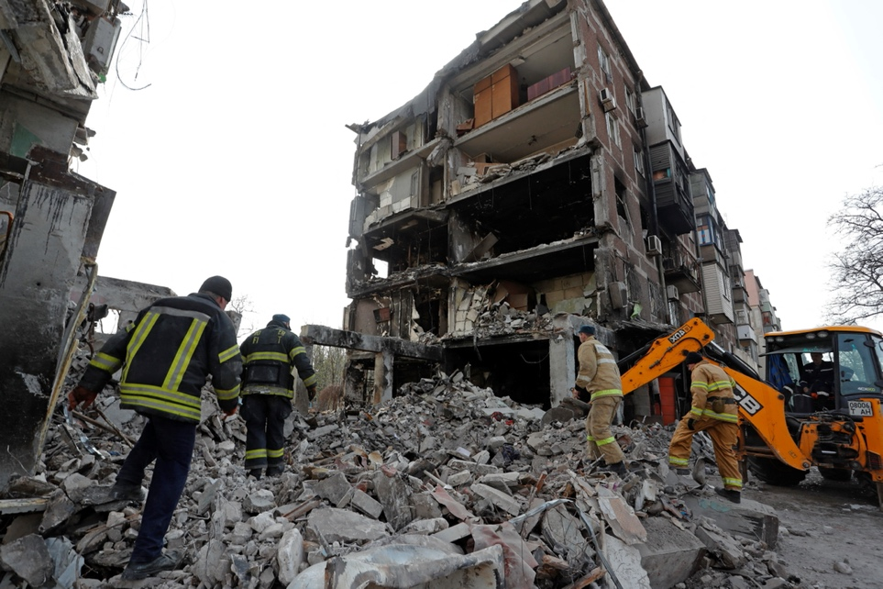
Russia’s war on Ukraine has upended much of the international order
A founding member of the United Nations – charged with ensuring international peace and security – is waging large-scale aggressive war
  Using nuclear threats as shield to protect its offensive war
A state that gave up the nuclear weapons on its soil for security assurances is being torn apart
Impacts on security, food, energy are reverberating around the world
U.S.-Russian talks cut off
Source: Reuters

Slide 6
The war in Ukraine requires rethinking most aspects of nuclear policy
With a more aggrieved Russia, more willing to use military force, and more willing to rattle the nuclear saber, nuclear deterrence needs new thinking
  With weakened conventional forces, Russia will be more dependent on nuclear weapons than before
  U.S. allies seeking still stronger assurances
The future of nuclear arms control is in doubt
  Intense U.S.-Russian hostility means more nuclear danger, fewer chances to take steps to reduce it
The future of nuclear nonproliferation is uncertain
  Ukraine’s fate may lead other countries to reconsider nuclear options
Requires rethinking nuclear energy, nuclear safety, and nuclear security with the possibilities of wars, political unrest, state collapse in mind
Notes:
MB

Slide 7
Cuban Missile Crisis: The tale of sub B-59
Diesel sub, designed for northern waters, not the Caribbean
  >110∘ on board – carbon dioxide high, sailors passing out
Sub armed with a nuclear torpedo – physical capability to fire
  U.S. Navy did not know it was nuclear-armed
U.S. Navy using “practice depth charges” to force it to the surface
  Those on sub believed war had begun, they were under attack
Captain reportedly ordered nuclear torpedo prepared for firing
Differing accounts of details – but agreement that Capt. Vasily Arkhipov – also on the sub by sheer chance – prevented use
The fog of crisis can lead to disaster

Slide 8
How might a nuclear war start?
Nuclear deterrence makes a rational decision to begin a nuclear war hard to imagine…
But Cold War crises, and pre-nuclear wars, highlight the dangers of unintended escalation, miscalculation in the heat of the moment, accidents, unauthorized use, decisions based on wrong information…
Leaders might believe a limited use of nuclear weapons could avoid devastating defeat – and they could deter further response
Source: Department of Energy
Notes:
Senior Russian strategists today are arguing that using a few nuclear weapons against several NATO countries would provoke fear that would cause NATO to back down, that Russia could deter any serious American response, and this would actually REDUCE the chance of a large-scale nuclear war.

Slide 9
Evolving technologies may be reducing deterrent stability
BMD, cyber, counter-space, precision conventional, automomy create new complexities → greater escalation risks
  Cyber blurs lines between peace and conflict, difficult to control
  Counter-space and cyber may both create incentives to hit first, early
  Missile defenses complicate strategic planning
  “Entanglement” of nuclear and conventional forces, command and control create incentives to escalate
  AI-enabled decisions may shorten decision time, change decision environment
Hypersonic weapon concept. Source: space.com
Notes:
BUT: the fundamental power of nuclear weapons, is not changing; U.S. building new strategic weapons designed to last decades that look a great deal like the previous ones. Over next couple of decades, continuity in nuclear balances likely to be as important as change.
1st poll: likelihood of nuclear use in next 10 years; 2nd poll, where might it start

Slide 10
Dateline: Russia
Aggressive war in Ukraine; nuclear threats, modernization, novel weapons, exercises; cyberattacks; election interference…
Intense U.S.-Russian tensions
  Almost all communication cut off – risk of escalation to direct conflict
Russian forces, command and control vulnerable; arms control in crisis; potential for launch on false alarm or unintended crisis escalation
Source: ITAR-TASS

Slide 11
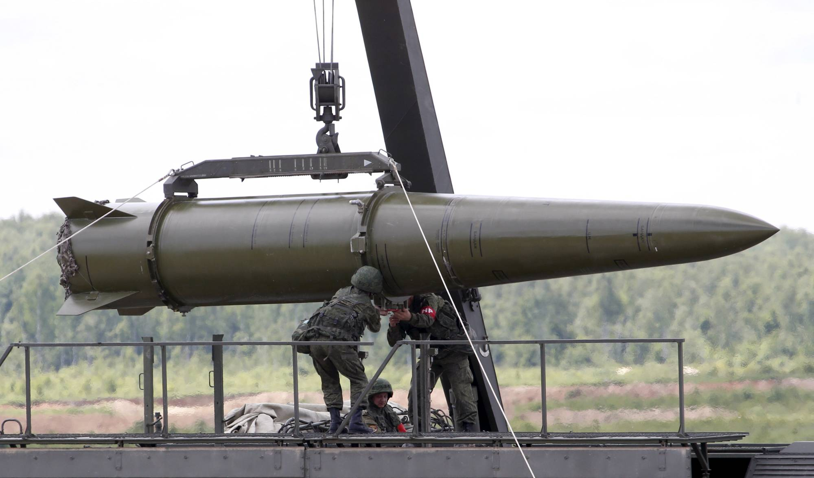
Will Russia use nuclear weapons during the Ukraine war?
Russian leaders might think could break “hurting stalemate,” stop a Ukrainian breakthrough, or end NATO support with nuclear use
  Destroy armored formations
  Threaten cities and demand surrender (Putin has referred to “precedent” of Hiroshima and Nagasaki)
  Use against NATO countries
US has threatened “catastrophic” response
  Might Russia conclude it could deter substantial retaliation?
Loading an Iskander missile, 2015 Source: Reuters

Slide 12
Dateline: China
Much smaller nuclear force, but major modernization underway
  ~400 weapons, but increasing
  100s of nuclear missile silos under construction – possibly a goal of parity with the United States
Heightened U.S.-China tensions – Taiwan, South and East China seas, trade, cyber, other issues
No arms control, verification, or dialogue on strategic issues in place
  China (and Russia) concerned over U.S. missile defenses, conventional strike capabilities, nuclear forces
Source: AP, Li Gang
Notes:
MB

Slide 13
Dateline: North Korea
Unpredictable dictator armed with dozens of nuclear weapons, ballistic missiles
  Flurry of missile testing, nuclear test any day, HEU, Pu production unabated
  Has threatened to rain “nuclear fire” on ROK, Japan, United States
History of provocations against ROK – could lead to conflict
Agreements, sanctions, threats have all failed
No clear prospects for “denuclearization”
Source: KCNA
Notes:
WT

Slide 14
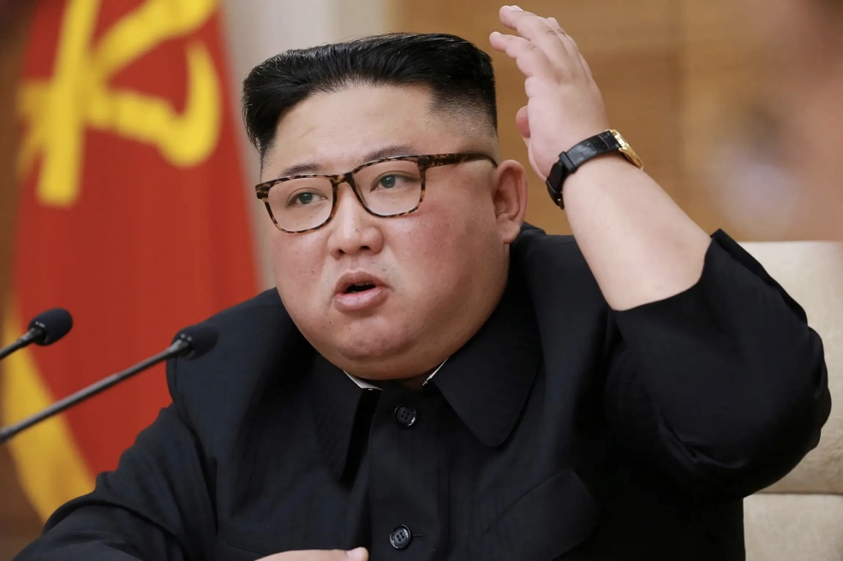
From Kim’s perspective:
A potential conflict scenario
Imagine:
  A major North Korean provocation – e.g., shelling an island again
  South Korea insists on striking back harder, to reestablish deterrence
  North Korea uses ~6 conventional missiles against a U.S. airbase
  ROK, U.S., begin an air campaign to destroy the DPRK’s missiles
DPRK faces “use them or lose them” pressures
Can they tell the air campaign is not intended as a prelude to an all-out regime-change attack?
Source: Reuters
Notes:
Would Kim be deterred from using nuclear weapons, or would he see using nuclear weapons as a way to scare us off from further attacks, and damage our military potential against him? Need to think more about intra-war deterrence.

Slide 15
Dateline: South Asia
Ongoing nuclear arms race between Pakistan and India – who have fought 4 wars
Military doctrines with unclear redlines; terrorists might provoke conflict; could blunder into war
  But have managed recent crises successfully
Pakistan has a growing nuclear arsenal, and some of the world’s most capable terrorists
Some modeling suggests even Indo-Pakistani nuclear war could cause “nuclear fall”
Source: Wikimedia Commons
Notes:
WT

Slide 16
Dateline: Iran
Nuclear agreement reduced risk – but attempts to rebuild it have failed
Iran now has ability to produce several bombs’ worth of HEU quickly
Iran continues to support terrorist groups, undermine countries in the region, threaten Israel, test longer-range ballistic missiles – and has never given an honest declaration of its past nuclear weapons efforts
  Israel/Hamas could become regional war
Where next?
Source: khamenei.ir
Notes:
MB

Slide 17
The surprising success of nonproliferation
No net increase in nuclear-armed states in 35 years
All but 5 states are parties to the nuclear Nonproliferation Treaty (NPT)
  Obligated not to get nuclear weapons, and to accept inspections
  Many other accords, initiatives, support the overall regime
  Never in human history has the most powerful weapon available to our species been so widely forsworn
What explains success?
  Most states realize they are better off if they and their neighbors don’t have nuclear weapons
  Treaty changes states’ decision-making: Foreign Minister, Finance Minister now more likely to be at the table, and nuclear weapons advocates need to reverse a decision already made
  NPT creates norms – easier to build coalitions against programs
Notes:
Mention Waltz “More May be Better” – but real policymakers have decisively rejected

Slide 18
But growing challenges to the global regime
Many states unhappy with the NPT – no consensus at reviews in 2015, 2022
More states reconsidering security options
Ongoing challenges controlling sensitive technologies – new tech. such as additive manufacturing makes more difficult
Possible spread of ostensibly civilian enrichment and reprocessing as nuclear energy grows and spreads
Ban Treaty manifests frictions
Source: AFP

Slide 19
Some good news about nuclear weapons
78 years with no nuclear attacks – amazing success
>80% of the world’s nuclear weapons have been dismantled
<5% of worlds states have nuclear weapons – same as 35 years ago
  No net increase in 3.5 turbulent decades – amazing success
>50% of the states that started nuclear weapons programs gave them up
  Efforts to prevent proliferation succeed more often than they fail
>50% of the states that once had potential nuclear bomb material on their soil have eliminated it
Nuclear material around the world is far more secure than it was 25 years ago – much harder for terrorists to get
  Most egregious weaknesses fixed – but more to be done

Slide 20
May still be options for reducing dangers
Both the United States and Russia have reasons to want to avoid an unrestrained arms competition
When the Ukraine war ends, new opportunities may open
Even if treaties are difficult to reach, may be able to use executive agreements, political commitments, unilateral-reciprocal initiatives to make progress
Though China rejects arms control for now, also good reasons for it to want to avoid unregulated race for the long haul
Variety of risk-reduction proposals still being put forward
”Track II” (non-government) dialogues are developing, stockpiling ideas for when governments are ready
  Have explored most of the key ideas needed for the next round of nuclear arms control – and some novel risk-reduction approaches

Slide 21
Further reading…
Full text of Managing the Atom publications:
http://belfercenter.org/mta
Full text of Bunn publications and presentations, by topic:
https://scholar.harvard.edu/matthew_bunn
“Pathways to Disaster: How Might a Nuclear War Start?” presentation, Oak Ridge National Laboratory, 2022 https://tinyurl.com/ypz7osd8
The Iran Nuclear Archive: Impressions and Implications, 2019 https://tinyurl.com/2o7gqcm3
Revitalizing Nuclear Security in an Era of Uncertainty, 2019
https://www.belfercenter.org/NuclearSecurity2019
“For Security’s Sake: Saving U.S.-Russian Arms Control,” presentation, Oak Ridge National Laboratory, 2018
https://tinyurl.com/y5u4p7xh

Slide 22
Back-up slides

Slide 23
We need risk-reduction action on each step on the pathway to nuclear war
Conflict
Nuclear use
Crisis
Peace
Key step: preventing crises. Any militarized crisis between nuclear-armed states is dangerous – ”fog of crisis” raises risks
  Avoiding crises is partly deterrence – but mainly foreign policy
  A more modest foreign policy for a dangerous nuclear era?
Preventing escalation from crisis to conflict
  Partly deterrence – partly de-escalation, reassurance
Preventing escalation to nuclear use
  Similar issues – but heavier emphasis on deterrence
How to reassure, reach resolutions, in atmosphere of hatred, fear, misperception, disinformation, time pressure?
Notes:
Talk about the many pathways people have envisioned… Can only analyze what we can imagine… Can try to collect data on the frequency/probability of each step… Use North Korea “kill-chain” scienario as an example.

Slide 24
“Rethinking Nuclear Deterrence”:
A global research network
Harvard-led research network launched in 2022, with support from the MacArthur Foundation
Why rethink nuclear deterrence?
  Terrible dangers and serious moral ambiguities of nuclear deterrence have always been there
  Changing geopolitics, changing technologies raise complex issues
  Need ideas to address changing dangers
Scores of scholars and practitioners from ~25 countries involved, in four working groups:
  Preventing nuclear war
  Legal, ethical aspects of nuclear deterrence
  Evolving technologies and arms control
  Beyond nuclear deterrence
  Other projects, outreach efforts, beyond the working groups

Slide 25
The importance of presidential judgment
Cuban Missile Crisis:
  Initially, Kennedy’s advisors called for air strikes followed by an invasion
  Kennedy pushed back, asking for another option
  The recommended course might well have led to nuclear war
Kennedy: Key lesson was always to give the adversary a choice between humiliating defeat and nuclear war
The world relies on sober judgment by the leaders of nuclear states
Source: JFK Library

Slide 26
Some key takeaways
Nuclear weapons continue to pose real risks to U.S. and global security, requiring constant attention to minimize
Evolving technologies may reduce deterrent stability – but there is likely to be more continuity than change
Nuclear arms control has had real benefits for U.S. and global security, and is worth trying to continue
The global effort to stem the spread of nuclear weapons has been surprisingly successful, and serves almost everyone’s interests
  But requires constant effort for continued success
Nuclear and radiological terrorism remain real dangers
Good policy has managed to reduce nuclear dangers in multiple areas – and can do so again in the future

Slide 27
Taking the “security dilemma” seriously
What U.S. actions for defense and deterrence might provoke adversary responses that undermine U.S. security?
Are U.S. missile defenses:
  Part of the cause of Russia’s new types of strategic nuclear weapons?
  Part of the cause of China’s buildup?
Are U.S. counterforce capabilities a major reason why Russia relies on a “launch on warning” strategy?
Do U.S.-ROK “kill chain” and decapitation strategies increase North Korean incentives for limited use of nuclear weapons early in a conflict?
Do U.S. and Israeli threats, operations, increase Iran’s desire for a nuclear weapons option?
Need to think through long-term net effect of U.S. actions

Slide 28
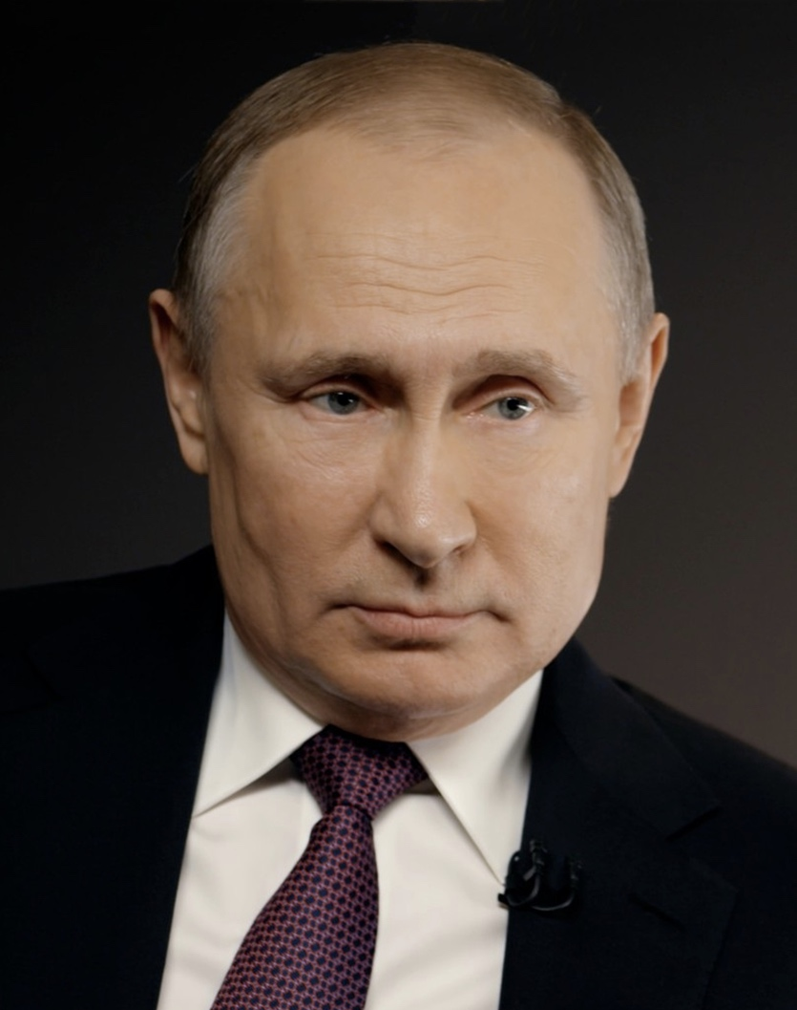
From Putin’s perspective: next steps in arms control
Imagine: it’s 2024, talks on a new arms control agreement are beginning
The U.S. wants
  Significantly lower numbers
  An accord that limits all warheads – including Russian tactical weapons
  On-site inspections at warhead sites
  Inclusion of new Russian weapon types in the treaty’s limits
  But the U.S. refuses any serious limits on missile defenses (including space-based ones) or precision conventional strike capabilities, Ukraine unresolved
Should Russia agree?
Source: kremlin.ru

Slide 29
From Xi’s perspective: participate in arms control?
Imagine: it’s 2024
The U.S., concerned about China’s growing (but still small) arsenal, wants China to agree to limits
  China doesn’t want to be formally locked into an inferior position
  But China wants to be seen as an advocate of disarmament
  U.S. is unwilling to constrain missile defenses that China sees as threatening its deterrent
What limits, if any, should China agree to?
  Formal, informal possibilities
Source: Muneyoshi Someya/Getty Images

Slide 30
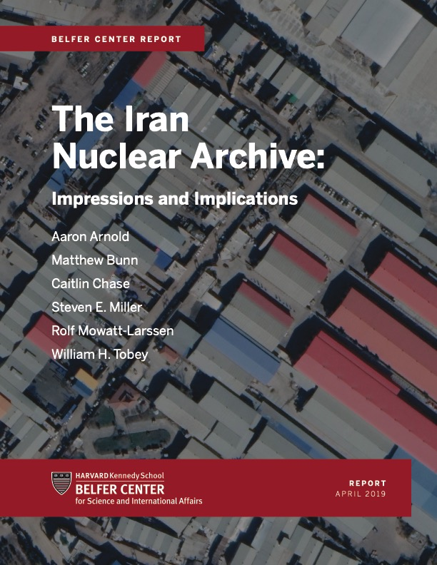
The Iran nuclear archive
6 key conclusions:
  Iran had focused program to produce, test nuclear weapons
  Made more technical progress than had previously been known
  Has ability to reconstitute
  Much more foreign assistance than previously understood
  Some facilities, activities went undetected
  Issues will have to be addressed in future deals
Many mysteries remain…

Slide 31
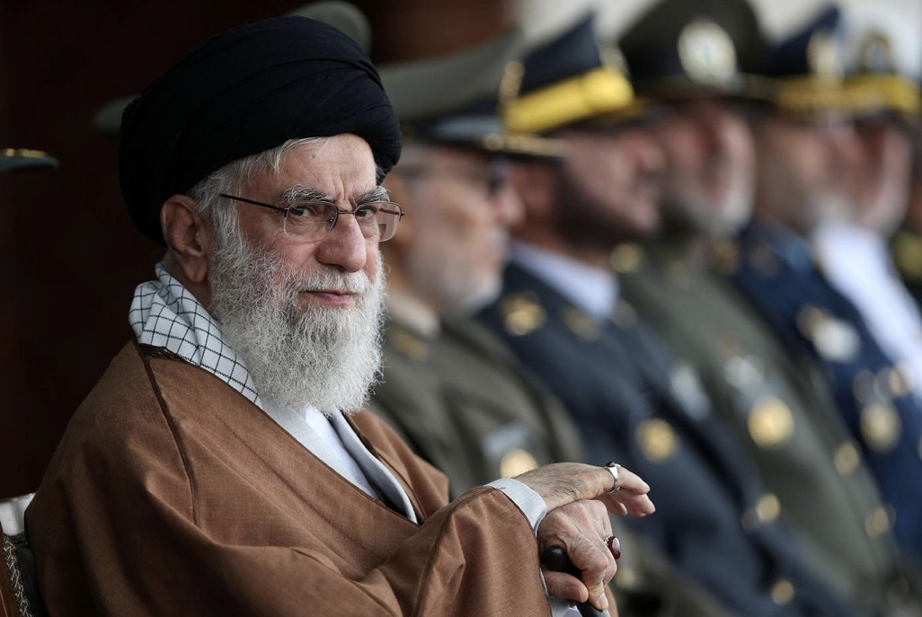
From Khamenei’s perspective: what to agree to, for what price?
Imagine: it’s 2023, all sides have returned to the JCPOA
U.S. is asking for new accord – longer timelines, limits on long-range missiles…
U.S. is offering broader sanctions relief in return
What should Iran be prepared to offer, for what concessions from the United States or others?
  What would make U.S. promises credible to you this time?
  Should you authorize a new deal?
Source: Anadolu Agency via Getty Images

Slide 32
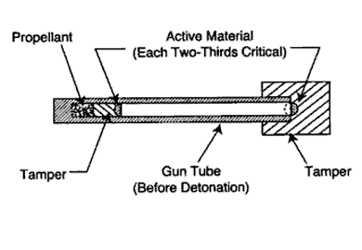
Dateline: Unknown
Nuclear and radiological terrorism
Numerous gov’t studies: terrorist group could plausibly make a crude bomb if it got material
~20 cases of seizure of stolen HEU or plutonium
Aum Shinrikyo, al Qaeda both pursued nuclear weapons
ISIS intent unclear, but had more money, people, territory under control, ability to recruit globally than al Qaeda ever had
Source: NATO

Slide 33
Dateline: Unknown
Nuclear and radiological terrorism (II)
Terrorists could also sabotage nuclear facilities (potentially cause Fukushima-scale accident), or use radioactive material in “dirty bomb”
Policy options
  Improve security for nuclear and radiological materials, facilities (How to sustain momentum with the summit process years in the past?)
  Block nuclear smuggling (How to find the needles in the haystacks?)
  Counter high-capability terrorist groups (How can we do better?)
  Prepare to respond (How much can this mitigate the harm?)

Slide 34
One U.S.-Russian nuclear arms control agreement left – what’s next?
ABM Treaty, INF Treaty, both terminated
Presidents Biden and Putin extended New START for 5 years – but what comes then?
New START is working
  Both sides have met key limits
  Inspections on hold as a result of pandemic
  Expires 2/2026
Intense U.S.-Russian hostility, Russian treaty violations, make it very difficult to reach, ratify new treaty
What about China? What about non-strategic nuclear weapons? What about missile defenses, counter-space weaponry, other factors affecting strategic stability?

Slide 35
Why should we care?
Benefits of nuclear arms control
Benefits of the agreements themselves:
  Reduced mutual perceptions of threat
  Force structure stability
  Predictability (important for planning)
  Transparency
  Reduced cost of maintaining forces
Benefits of the arms control process:
  Discussions allow greater mutual understanding of nuclear policies, plans, perceived dangers
  Build relationships, habits of cooperation that spill over to other areas
  Offers arena in which Russia is treated as an equal – helps assuage prestige, humiliation concerns

Slide 36
Dateline: United States
Strategic modernization
U.S. strategic weapons are aging
Obama administration laid out a plan for new ICBMs, SLBMs, submarines, bombers, and cruise missiles, with “life extended” (upgraded) warheads
Trump endorsed, expanded with new low-yield SLBM, nuclear SLCM, new warhead – Biden budget continues
>>$1 trillion cost over 30 years
Bipartisan support – especially with Ukraine war
  But we need a broader debate over deterrence needs, costs, risks, arms control
  Some say further weapons needed
Source: DOD

Slide 37
The rest of the Middle East – and East Asia
Iran’s program has given other countries in the region incentives to explore nuclear options
  Saudi Arabia – statements threatening to get nuclear weapons if Iran does; possible deal with US for both reactors and enrichment
  Egypt – past safeguards violation never fully resolved; expanded civilian nuclear energy plans
  Turkey – new statements calling NPT commitment into question, expanded civilian nuclear energy plans
North Korea’s program gives its neighbors incentives to worry – especially if extended deterrence weakened
  Japan (full fuel cycle in place), ROK (majority support for nuclear weapons), Taiwan (faces growing threats, weaker U.S. commitment)
Few apparent risks in other regions
Notes:
3rd poll – how many NW states 10 years from now

Slide 38
Dateline: Global
Chemical and biological threats
Current pandemic shows the impact contagious disease can have
  Imagine if more contagious, more deadly
Widespread chemical use by Syria – even after alleged disarmament
North Korea and Russia apparently used chemical weapons for assassinations—may indicate other stocks
Terrorists have pursued chemical, biological weapons
  Islamic State produced, used its own mustard gas
  Aum Shinrikyo conducted nerve gas attacks in Tokyo subways
  Aum Shinrikyo, al Qaeda pursued anthrax, other biological agents
  New gene editing technology (e.g., CRISPR) could increase risks
Some state biological weapons programs persist
Deep dual-use dilemmas, verification challenges
Notes:
MB – after this slide but before the next, do risk-informed approach discussion

Slide 39
Group assignment: allocate effort to reduce nuclear risks
What percent of total nuclear risk reduction effort (high-level political attention, $, other resources) should be allocated to reducing risks posed by:
  U.S.-Russian conflict
  U.S.-China conflict
  North Korea
  Iran
  South Asia conflict
  Nuclear/radiological terrorists
  Other?
Base allocations on:
  Scale of risk to U.S. or global security (probability x consequences)
  Degree to which U.S. or global policies could reduce the risk
Notes:
WT

Slide 40
A risk-informed approach
Risk: probability x consequences
What’s the problem?
  Identify, prioritize, risks and objectives
What are the options to address it?
  Start with broad categories – get specific later
What are the plausible outcomes of each option?
  Estimate probability, consequences of each outcome
Choose the option that offers lowest risk/most benefit
In real life, these judgments are highly uncertain, debatable –
but this approach offers a structure for thinking and choice
Notes:
WT

Slide 41
Iran: should Obama have cut a deal?
Criteria
Minimum chance of Iranian bomb
Impact on other Iranian threats, regional, global security
Impact on regional, global proliferation risk
Costs and security risks
Impact on human well-being
Impact on politics of Middle East, Iran…
Impact on U.S., U.N. leadership, credibility
Decision
Negotiate, no compromise
?
Negotiate, compromise
?
Military strikes
?
Acquiesce
?
Risk

Slide 42
Comparing the alternatives
Decision
Negotiate, no compromise
High
Negotiate, compromise
Medium
Military Strikes
Very High
Acquiesce
Very High
Risk
Notes:
If time – do 2nd group exercise after this slide – otherwise, just have discussion in class.

Slide 43

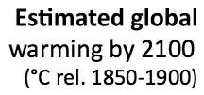
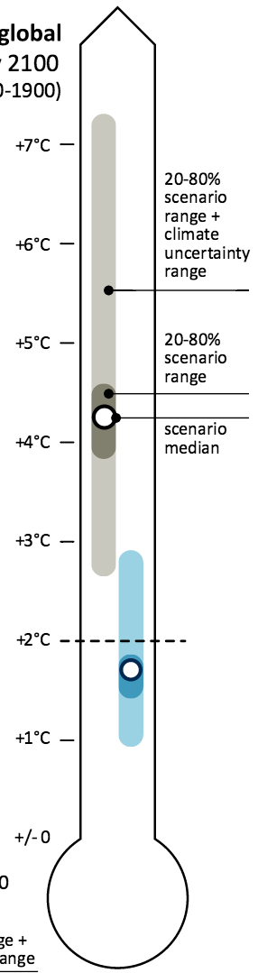
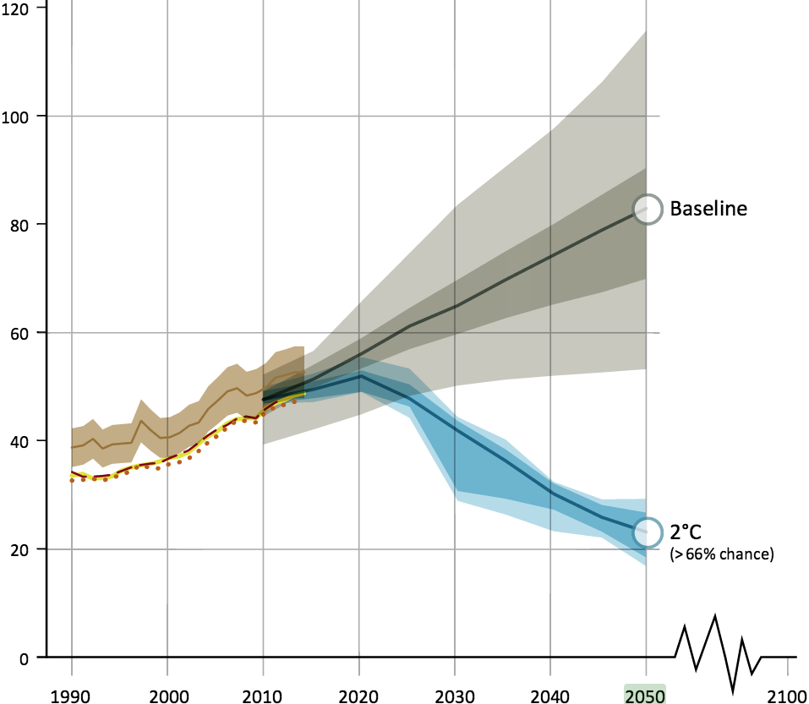
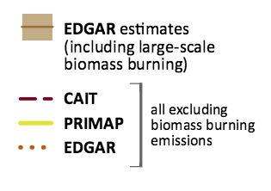
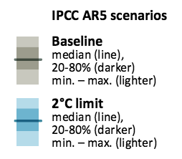
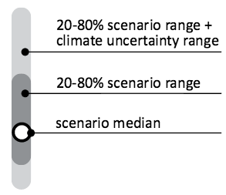
Huge, transformational nuclear growth needed for substantial climate role
Carbon displaced by the IAEA high nuclear growth case
}

Slide 44

Particulates may be even more important than climate in driving clean energy
Smog in Beijing. Source: inhabitat.com
>3 million deaths/yr globally from fine particulates

Slide 45
Key constraints on large-scale nuclear energy growth – can they be loosened?
Economics
Safety risks – real and perceived
Security risks – real and perceived
Nuclear waste management – mostly politics
Siting and public acceptance
Limited government and industry capacity
Stringent regulation
Proliferation risks – mainly from the nuclear fuel cycle
U supply: Not likely to be a constraint this century
In each area, both new policies and new technologies have the potential to loosen past constraints on growth

Slide 46
Maintaining U.S. nuclear influence
U.S. role in the nuclear market is now greatly reduced
But the United States offers world-leading innovation, and approaches to safety, security, and nonproliferation
Both economic and security benefits to maintaining a significant U.S. position in nuclear markets
  Important to U.S. influence over other countries’ nuclear choices
President Biden has to grapple with:
  How to avoid losing nuclear’s domestic low-carbon contribution
  How to ease the path to commercializing new technologies
  How to help U.S. firms compete against state-owned (or assisted) firms from other countries
  How best to advance U.S. nuclear safety, security, nonproliferation objectives

