Slide 1

Next steps to prevent nuclear and radiological terrorism -- including actions for Congress
Matthew Bunn
Professor of Practice, Harvard Kennedy School
Capitol Hill Briefing
July 11, 2017
belfercenter.org/managingtheatom

Slide 2
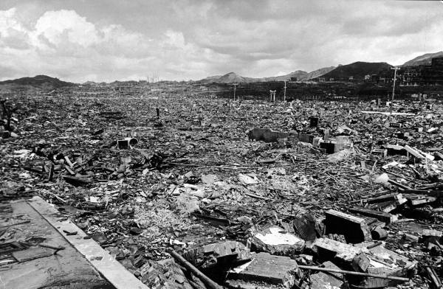
Could terrorists do this to a modern city?
Source: LIFE, photographer: Bernard Hoffman

Slide 3
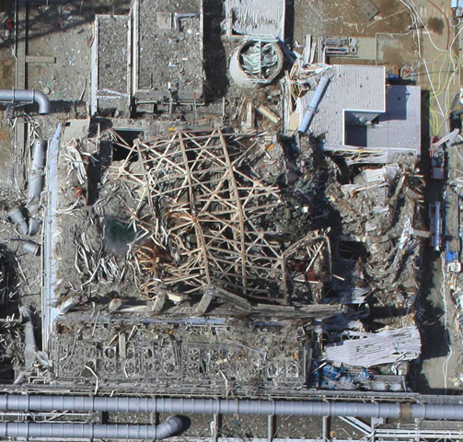
Nuclear terrorism is a serious danger
Multiple government studies warn that a sophisticated terrorist group could potentially make a crude nuclear bomb if they got the material
Terrorist sabotage could cause a Fukushima-scale nuclear accident
A “dirty bomb” spreading radioactive material could cause expensive disruption, if few deaths
Terrorist plots suggest possible ongoing interest
  E.g., ISIS monitoring of senior nuclear official in Belgium
Source: Air Photo Service, Japan

Slide 4

A recent example: insider sabotage and a cleared terrorist at Doel-4
August 2014: An insider at Doel-4 reactor in Belgium drains lubricant, destroys reactor turbine
  ~$200 million damage
  Investigators unable to find culprit
  Sabotage intended to cause economic damage, not radiation release
Investigation finds that long before, contractor Ilyass Boughalab had access to vital area
  Passed security clearance review in 2009
  In late 2012, left to fight for terrorists in Syria (reportedly killed later)
  Later convicted as part of “Sharia4Belgium” terrorist group
Source: Kristof Pieters

Slide 5
Need: a comprehensive program to reduce the risk of nuclear and radiological terrorism
A comprehensive, action-oriented plan
  Going after the material – secure, minimize
  Going after the smugglers – find, interdict, impede
  Going after terrorist groups with nuclear potential
Resources, authorities to implement the plan
Someone in charge – with the right support, authorities
Indicators to judge progress
Process for learning, adapting, to optimize effectiveness
Today:
Nuclear security efforts losing momentum after summits
Intelligence effort focused on nuclear, biological, chemical terrorism small, largely reactive rather than proactive
Only pieces of comprehensive program in place
No clear progress indicators, means to learn and adapt

Slide 6
Going after the material
Goal:
  Effective, sustainable security for all nuclear weapons and weapons-usable material worldwide – includes minimizing stocks, locations
  Also need better security for nuclear facilities, radiological sources
Current:
  Dramatically improved nuclear security over past 25 years
  But effort losing momentum a year after nuclear security summits
  U.S. nuclear security programs shrinking, slowing
Need to revitalize U.S. nuclear security programs
  From paying for upgrades to convincing states to do more themselves
  Equally applicable in rich countries and poor countries
  Will be hard to convince countries to take steps we don’t take in U.S.
  Particularly important targets for cooperation
    Russia
    Pakistan
    India

Slide 7
Going after the material (II)
Revitalized nuclear security programs should focus on genuinely effective implementation in 5 key areas
  Protecting against the full spectrum of plausible adversaries
    Are countries defending against everything they should be protecting against?
  Multilayered defenses against insider threats
    Insiders have been key to most real nuclear theft, sabotage incidents
  Focused programs to assess, strengthen nuclear security culture
    Need all security-relevant staff to be vigilant, aware
  Realistic vulnerability assessment and performance testing
    Do nuclear security systems really work, in the face of creative adversaries looking for weak points?
  Consolidating to fewer sites
    Can provide better security at lower cost protecting fewer places

Slide 8
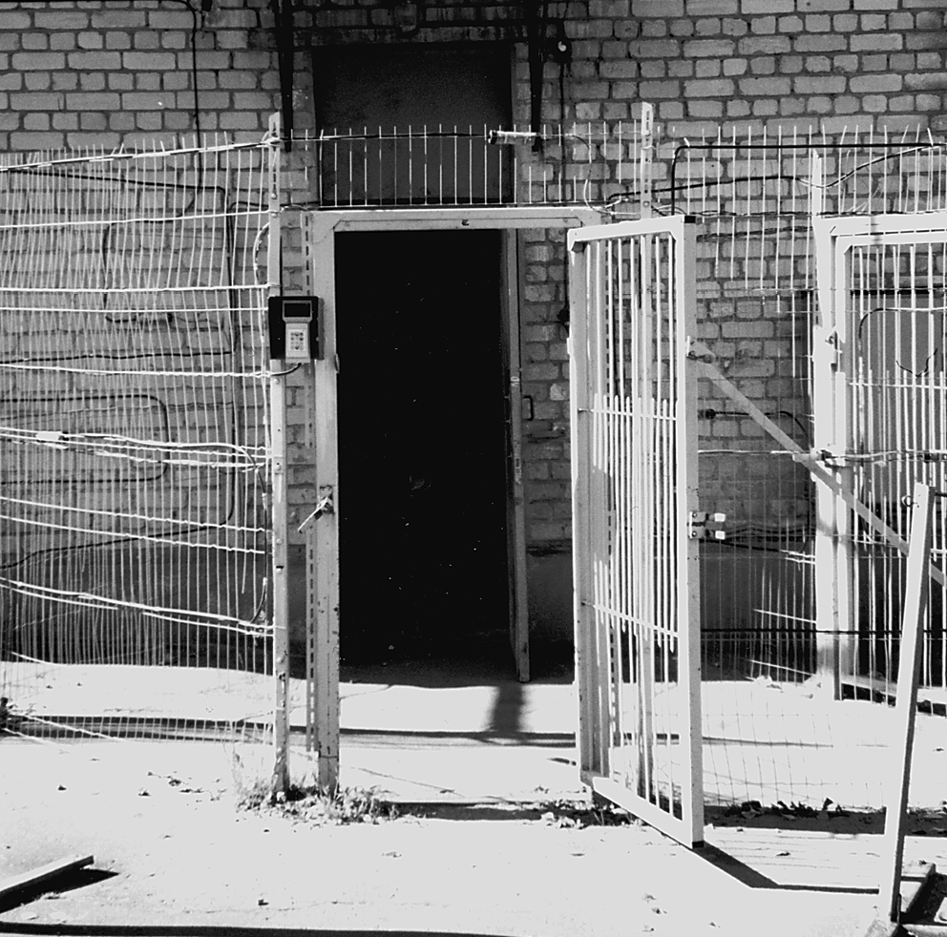
Security culture matters:
Propped-open security door
Source: GAO, Nuclear Nonproliferation: Security of Russia’s Nuclear Material Improving, Enhancements Needed (GAO, 2001)

Slide 9
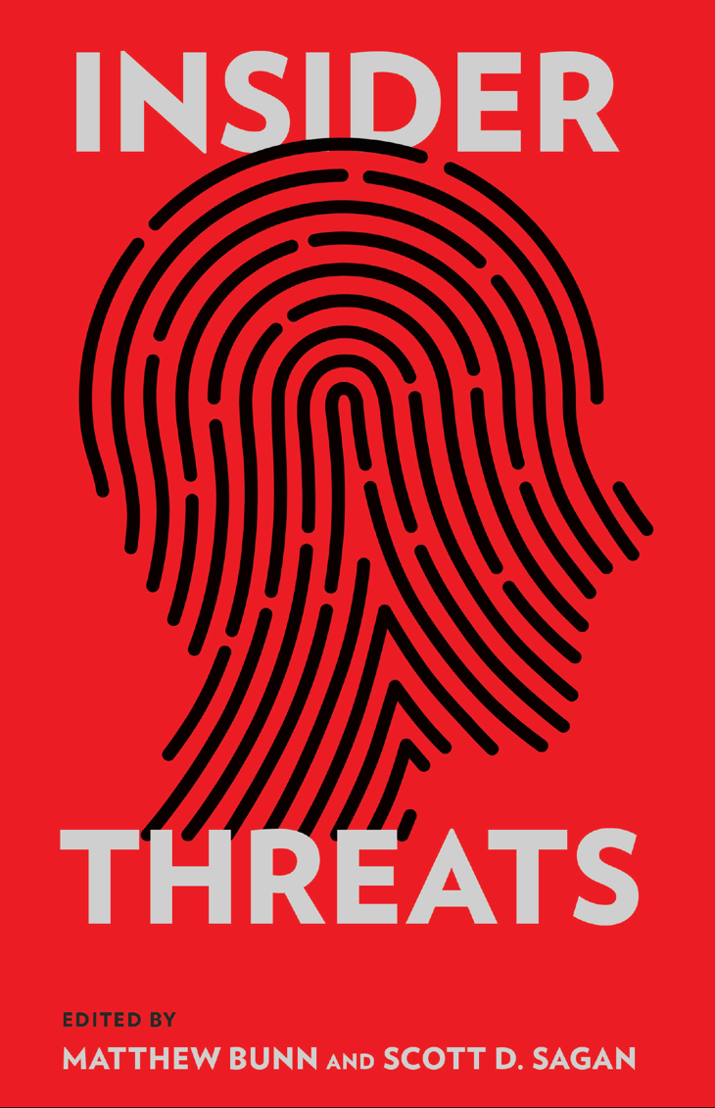
Insider threats are the most dangerous nuclear security problem
The known HEU and Pu thefts, and most sabotages, involved insiders
People don’t want to believe their friends and colleagues could betray the organization
  Leads to serious lapses in protection against insider threats
Getting people to report suspicious behavior is very difficult
Often even obvious “red flags” go unreported, unaddressed
Bunn-Sagan book offers case studies, “Worst Practices Guide” on lessons learned from past mistakes
http://www.belfercenter.org/
publication/insider-threats

Slide 10
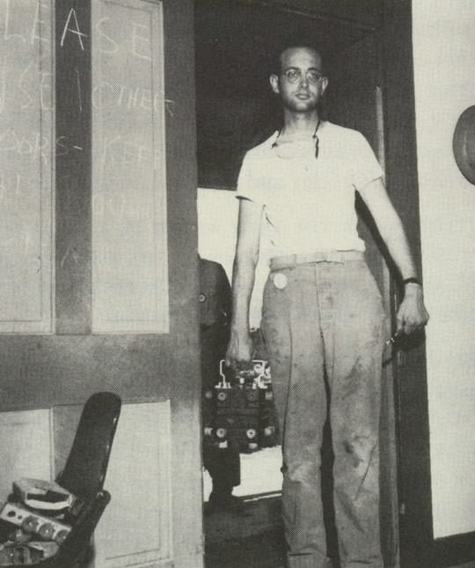
Going after the smugglers
The material for a bomb is small and hard to detect
  Once stolen, could be anywhere
1st priority: national police/intelligence teams
  Trained, equipped to deal with nuclear smuggling cases
  Proactive – stings, other efforts to penetrate networks
2nd priority: nuclear detection
  Key points – e.g., ports, border crossings that are hard to go around
  Mobile detection in high-risk areas for smuggling
  Focus on approaches that can cope with shielding, other adversary efforts to defeat
Source: Los Alamos

Slide 11
Going after the terrorist groups with nuclear potential
Only sophisticated groups with extreme ambitions pose significant nuclear risks, e.g.
  ISIS (only hints of interest so far)
  al Qaeda
  Other groups in future
Current counterintelligence effort critical but insufficient
Need focused, proactive intelligence effort to uncover terrorist nuclear plots
  Targeted team after 9/11 uncovered multiple nuclear, biological, chemical plots
  Today’s effort mostly reactive – waiting for leads
  Proactive effort, with stings and other techniques, could probe terrorist demand, smugglers’ supply
  Sharing effort internationally – including with Russia – could increase effectiveness
  If a focused team was unable to find real sources of HEU or plutonium after a sustained effort, likely terrorists would also be unable to do (the “Armageddon Test”)

Slide 12
Congress should help launch a reformed effort
Congress led the way in launching Cooperative Threat Reduction – >2 decades of bipartisan support
Options:
  Direct administration to undertake comprehensive, multi-pronged effort to secure nuclear and radiological weapons, materials, and facilities worldwide, take other steps to reduce the risk of nuclear and radiological terrorism
  Direct, fund a revitalized set of nuclear security programs
  Direct, fund targeted, proactive intelligence team
  Require a report on a comprehensive strategy
  Establish a bipartisan commission to recommend a strategy
In any of these approaches, important to:
  Ensure sufficient resources to implement the effort
  Ensure appropriate leadership, authority
  Provide regular oversight
    Have been no in-depth hearings on this threat for years

Slide 13
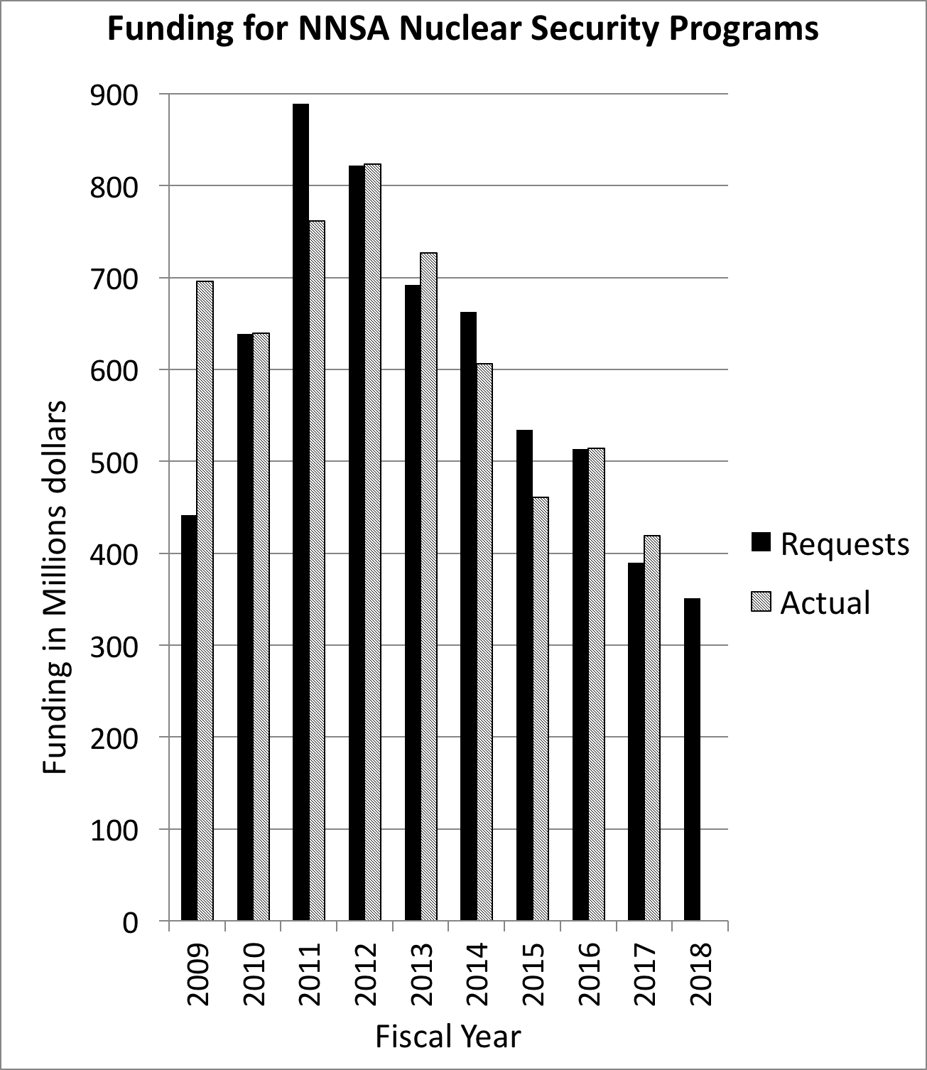
Congress should provide increased funding
Funding for nuclear security efforts has been cut year after year – now at lowest levels in >20 years
Trump proposes further cuts
More funding would be needed for revitalized effort
  Request is enough for limited current efforts – not for a broader, stronger program
  In particular, Congress should block proposed 50% cut to “Nuclear Material Removal” and proposed 30% cut to “International Nuclear Security”
Congress should direct administration to identify funding needed for comprehensive effort

Slide 14
Congress should help launch renewed, reformed nuclear cooperation with Russia
Russian behavior challenges U.S. interests in many areas
  Sanctions remain justified
  Some skepticism about cooperation remains justified
But lack of dialogue, cooperation with world’s largest nuclear complex threatens U.S. interests
  Leads to greater nuclear security weaknesses
  Denies U.S. experts Russian expertise, test facilities, R&D approaches
  Leads to less understanding of what’s happening
  Degrades relationships crucial to managing crises as they arise
United States, Russia, should launch renewed nuclear energy, nuclear security, nuclear safety cooperation – each side paying its own way, sharing ideas, doing joint projects
  Not U.S. ”assistance” to Russia
Congress should lift or greatly modify NDAA prohibition on contracts with Russian entities – undermines U.S. interests
  Should also encourage, not restrain, mil-mil contacts

Slide 15
Congress should support the proposal to end the MOX program
Program to use excess U.S. plutonium as mixed oxide (MOX) fuel in U.S. reactors is simply too expensive (~$1B/ton!)
“Dilute and dispose” provides viable, lower-cost alternative
  Simple mixing process requiring no new buildings
  Disposal form safe, reasonably difficult to recover plutonium
  Still uncertainties on WIPP disposal, but diluted mix could be stored until other repositories become available
May be possible to amend plutonium agreement
  U.S. agreed to amend agreement to accommodate changed Russian approach
  Russian attitude likely determined by broader U.S.-Russian relations, whether other nuclear cooperation being restarted
  In any case, security benefits of the agreement are real but modest – not worth tens of billions of dollars
  U.S. policy should focus on maintaining highest possible standards of security and accounting throughout process – in both countries – and verification of process as foundation for limits on fissile material stockpiles

Slide 16
Congress should support minimizing dangerous nuclear materials
Successful effort so far
  100s of buildings around the world have been cleared of HEU, Pu
  >50% of all the countries that once had HEU or Pu have eliminated it
  But more to be done – especially in Russia
Support efforts to convert HEU-fueled research reactors and isotope production to LEU that can’t be used in a bomb
  Robust funding for development of new LEU fuels
  Possible amendment: prohibit FDA licensing of new isotope producers using HEU (mainly a concern about Russia)
  Fund R&D program to develop LEU fuels for future naval reactors
Support efforts to work with countries on alternatives to plutonium reprocessing, better ways to reduce Pu stocks
  Dry cask storage, multinational repositories could change incentives
  Work with Japan, UK, others on alternatives to MOX
  Seek to ensure high standards of security and accounting for all plutonium processing

Slide 17
Further Reading
Preventing Nuclear Terrorism: Continuous Improvement or Dangerous Decline? (2016):
http://belfercenter.ksg.harvard.edu/files/PreventingNuclearTerrorism-Web.pdf
The U.S.-Russian Joint Threat Assessment of Nuclear Terrorism: http://belfercenter.ksg.harvard.edu/files/Joint-Threat-Assessment%20ENG%2027%20May%202011.pdf
Insider Threats:
http://www.belfercenter.org/publication/insider-threats
Nuclear Security Matters:
http://nuclearsecuritymatters.belfercenter.org/
Full text of Managing the Atom publications:
http://belfercenter.org/managingtheatom

Slide 18
Backup slides if needed…

Slide 19
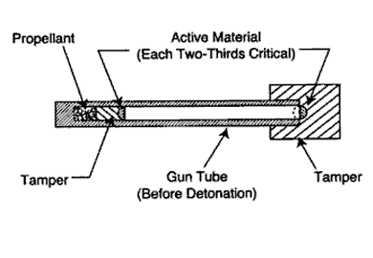
With nuclear material, terrorists may be able to make crude nuclear bombs
With HEU, gun-type bomb – as obliterated Hiroshima – very plausibly within capabilities of sophisticated terrorist group
Implosion bomb (required for plutonium) more difficult, still conceivable (especially if they got help)
  Doesn’t need to be as complex as Nagasaki bomb
Source: NATO
Doesn’t take a Manhattan Project -- >90% of the effort was focused on producing nuclear material. And making a crude terrorist bomb is far easier than making a safe, reliable weapon

Slide 20
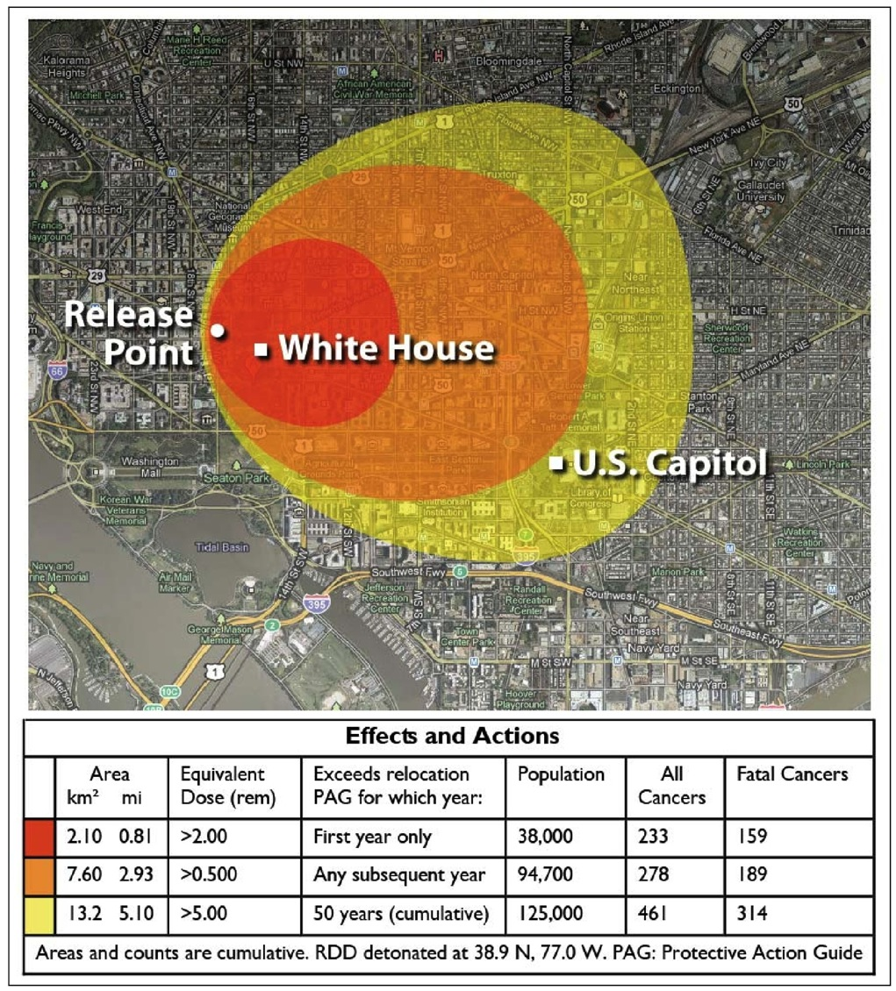
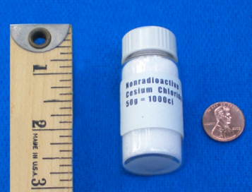
Cs-137
“dirty bomb”
Potentially dangerous sources used in hospitals, industry, in almost every country
Al Qaeda, Chechens have repeatedly considered dirty bomb attacks
Source: Congressional Research Service, modeling by Sandia National Laboratories, 2010
Notes:
Changed slide completely

Slide 21
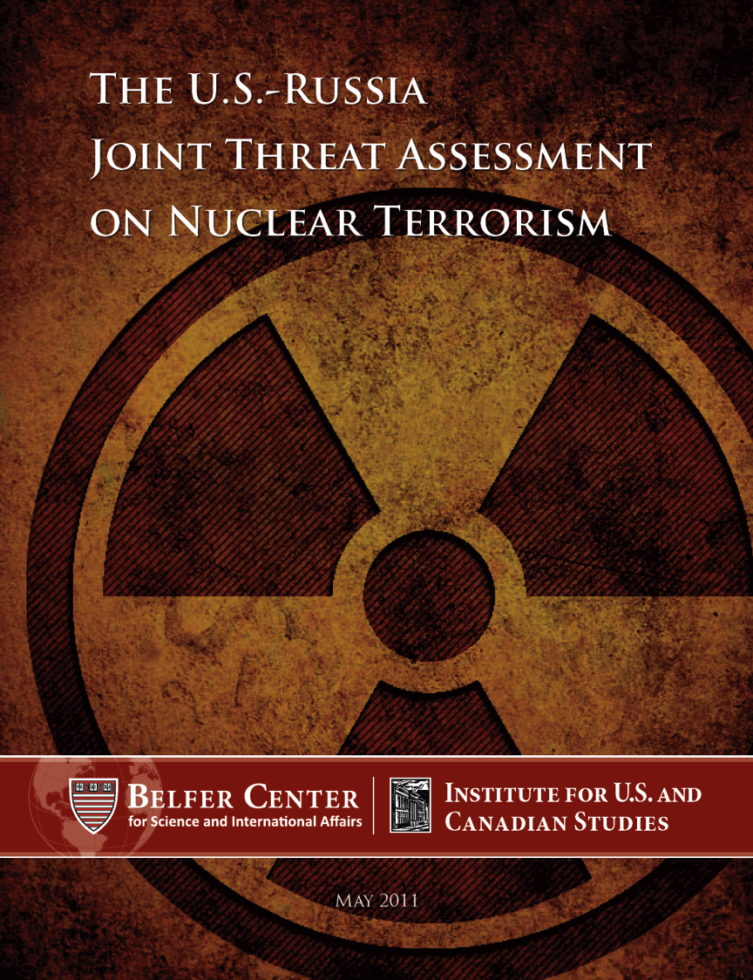
Not just a U.S. view
First ever U.S.-Russian joint threat assessment
Concludes the danger is real, urgent action is needed to reduce it
Endorsed by broad range of retired military, intelligence experts
http://belfercenter.ksg.harvard
.edu/publication/21087/

Slide 22

The amounts of material required are small
For simple “gun-type” bomb (with reflector): ~ 50-60 kg of HEU (Hiroshima bomb was 60 kg of 80% enriched material)
  Fits in two 2-liter bottles
For 1st-generation implosion bomb:
  ~6 kg plutonium (Nagasaki)
  ~ 3x that amount of HEU
The size of the plutonium core for the Nagasaki bomb
Source: Robert del Tredici

Slide 23
The insider threat – the biggest issue
All known thefts of HEU or plutonium appear to have been perpetrated by insiders or with insider help
  ~20 cases well-documented in unclassified literature
  Many involve bulk material never noticed to be missing until it was seized
Many factors lead organizations to understate insider dangers
  Excessive trust in people you know, excessive reliance on background checks, cognitive biases, unwillingness to report concerning behavior…
  Insiders may understand the security system, how to overcome it
Widespread insider theft from non-nuclear facilities in Russia
  Example: insider conspiracy to steal hundreds of items from the Hermitage
Notes:
Modified 3rd sub-bullet on Russia

Slide 24
The outsider threat – also an issue
Could outsiders attack – or sneak into – a nuclear facility or transport (possibly with insider help)?
  Example: 2007 intrusion at Pelindaba nuclear facility in South Africa – 2 teams of armed men, likely insider help
  Countless non-nuclear theft examples all over the world, some with paramilitary-level capabilities and tactics
How plausible are large, complex attacks like Beslan or the NordOst seizure in today’s Russia? Tomorrow’s?
  Large-scale insurgency largely crushed
  But strong links of some groups to Islamic State, al Qaeda
  Recent attacks have generally been simpler bombings – but some troubling indicators suggest potential for greater capabilities

Slide 25
Russia’s nuclear complex
HEU and Pu in ~200 buildings at dozens of sites
  Nuclear weapons complex mostly in 10 “closed nuclear cities” – hundreds of tons of plutonium and HEU
  Major civilian facilities also have HEU and plutonium, from research institutions to large fuel fabrication plants
  Major bulk processing facilities (biggest insider theft risks):
    Mayak, Ozersk (closed city, likely site of past theft attempt)
    Siberian Chemical Combine, Seversk (closed city)
    Novosbirsk plant (open city, known past thefts)
    Elektrostal plant (open city, known past thefts)
    Luch, Podolsk (open city, known past theft)
    Scale of current processing unclear: Zheleznogorsk, Zelenogorsk, Novouralsk (closed cities)
Nuclear weapons in >100 bunkers at ~ 40 sites (in addition to deployed ICBMs and SLBMs)
34 operating power reactors, huge #s of large sources
Notes:
Modified 3rd sub-bullet on Russia

Slide 26
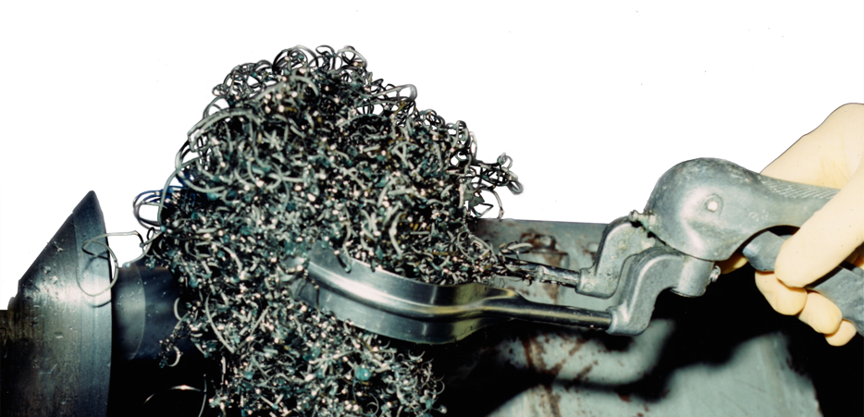
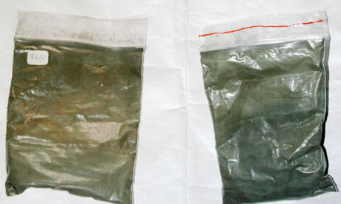
Nuclear material in forms that an insider can easily access and remove
Source: ORNL
Source: Reuters, from Georgian Interior Ministry
Source: Frank von Hippel

Slide 27
Major nuclear security improvements in Russia – but what’s happening now?
U.S.-funded nuclear security upgrades occurred at ~ 90% of Russian weapons-usable nuclear material buildings, nuclear warhead storage sites
  Also improvements Russia made on its own
  All the most egregious weaknesses fixed, risk greatly reduced
But:
  Some remaining weaknesses (e.g., accounting systems not required to track trends, needed to detect protracted theft)
  How effective is day-to-day implementation?
  How strong is security culture?
  Will they all be sustained?
  Will Russia do the work of further improvement, to cope with evolving threats, changing technologies, discovery of new vulnerabilities?
Fundamental issue: complacency (“it’s good enough, don’t worry”)
Notes:
Modified 3rd sub-bullet on Russia

Slide 28
How does Russia’s economic picture affect the risk?
Ongoing recession, low oil prices, devaluation of the ruble
  Over next several years, will there be recovery, or a 1998-style crisis? What are the probabilities?
  What effect is the economy having on incentives for nuclear theft? How would that change in the event of a major crisis?
Major government programs – including Rosatom – facing budget cuts
  10% of state employees to be reduced
  Funding for new reactors cut significantly
  Other parts of nuclear industry likely facing cuts
Will budget cuts lead facilities to cut corners on security?
  Facilities need to find money to meet security rules from general funds – every incentive to cut where possible
  Nuclear security rules still have significant weaknesses
Notes:
Modified 3rd sub-bullet on Russia

Slide 29
How does spreading Islamic extremism affect the risk?
What are the chances of one or more insiders being:
  Self-radicalized? (E.g., Ilyass Boughalab in Belgium)
  Recruited?
  Duped or entrapped? (E.g. Clinton jail case in U.S.)
  Coerced? (E.g., kidnapping family)
How effective would Russian security services be in identifying such a threat in time?
  Does the answer vary by type of facility? (Greater counter-intelligence focus on military facilities.)
Could Islamic terrorist groups put together a sophisticated outsider attack?
  How effective would Russian security services be in detecting and stopping such a conspiracy?
Notes:
Modified 3rd sub-bullet on Russia

Slide 30
How does ongoing corruption affect the risk?
Corruption has deeply penetrated the nuclear industry
  Director and 2 deputy directors of large HEU and Pu facility arrested for corruption
  Commander of nuclear weapon site relieved of duty for corruption
  Rosatom has launched anti-corruption program with Transparency International
Issue may be as much working-level corruption (guards, people with access to material) as high-level corruption that makes news
How much does engaging in low-level, “normal” corruption affect the chance an insider would participate in nuclear material theft or sabotage?
  Undermining inhibitions
  Greed and blackmail both possible
Notes:
Modified 3rd sub-bullet on Russia

Slide 31
How does the evolving organized crime picture affect the risk?
Substantial organized crime presence in communities with major nuclear facilities
  E.g., heroin networks in Ozersk and Snezhinsk
  Recent heroin seizures in both Novosibirsk and Elektrostal
What are the odds that organized crime groups would consciously get into the business of nuclear theft and smuggling?
To what degree could nuclear thieves and smugglers make use of organized crime groups without the group’s knowing the goods they were helping to smuggle were nuclear?
To what extent does promixity – organized crime activity nuclear facilities – matter?
Notes:
Modified 3rd sub-bullet on Russia

Slide 32
Questions we’d like to answer
How effective are Russia’s programs to protect against insider threats?
  How is the answer changing over time?
How effective are Russia’s programs to protect against outsider threats?
  How is the answer changing over time?
How are economic conditions, corruption, violent Islamic extremism, and organized crime affecting insider threats in Russia?
  How is the answer changing over time?
How plausible is a substantial, complex, outsider assault on a Russian nuclear facility?
  How is the answer changing over time?
What indicators could be tracked to help understand how answers to these questions are evolving?
Notes:
Modified 3rd sub-bullet on Russia

Slide 33
Documented seizures, 1992-2006 (more seizures in 2010, 2011)
Source: Los Alamos National Laboratory, Tom Bielefeld

Slide 34
August 2014: Sabotage at Doel-4 – and a terrorist in the vital area
Insider opened a locked valve, allowed turbine lubricant to drain out
  Turbine destroyed, reactor down for months
  $100-$200 million in economic damage
  Perpetrator, motive still unknown – clearly not intended to cause radioactive release
Investigators found an earlier worker had left to fight for the Islamic State
  Ilyass Boughalab had passed security clearance to work in the plant vital areas
  Convicted in absentia of terrorist activities as part of “Sharia4Belgium” terrorist group
Belgium imposed tougher insider protection rules
  Better access control, more security cameras in key areas, more use of two-person rule
Notes:
Modified 3rd sub-bullet on Russia

Slide 35
Does the rise of the Islamic State change the picture?
So far: no clear evidence of a nuclear weapons effort
But: apocalyptic ideology envisions final battle between “crusaders” and Islamic forces
  Nuclear weapons could be seen as key part of such a titanic struggle
Recent extended monitoring of senior official of Belgian site with substantial stocks of HEU a troubling indicator of potential nuclear intent
If they ever did seek nuclear weapons, may be in better position to do so than past terrorist groups
  More people
  More money
  More control of territory
  More ability to recruit experts globally

Slide 36
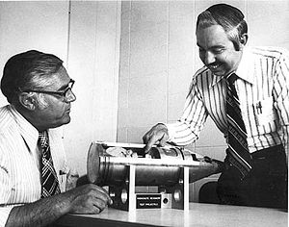
Nuclear security: the global picture
Global stockpiles include:
  ~15,000 nuclear weapons
  ~ 500 tons of separated plutonium
  ~1370 tons of HEU (+/- 125 tons)
  <1/3 of plutonium and HEU is physically in nuclear weapons
Stocks located in 100s of buildings, bunkers, in 29 countries
Widely varying security
No global rules specify how secure nuclear weapons or the materials to make them should be
W-48 nuclear artillery shell, one of many thousands of tactical nuclear weapons that have been dismantled
Source: U.S. Department of Energy
Theft of 0.01% of world stockpile could cause a global catastrophe

Slide 37
Nuclear security: the global picture (II)
~20 cases of seizure of stolen HEU or plutonium – most recently in Moldova in 2011
Can be thought of as global system with 100s of nodes
  Only as strong as weakest link – failure at any one node could cause horrifying catastrophe
  No central control over nodes
  Minimal ability to find and fix the weakest nodes
Key purpose of all the global agreements, initiatives, summits is to convince states to strengthen nodes within their borders
  But very little understanding of the factors that motivate change within individual states
Probability of nuclear terrorism may be modest, but consequences are huge – justifies urgent action to reduce the risk

Slide 38
Drivers of nuclear security: the data problem
No agreed measure of nuclear security
  NTI Index assesses answers to yes/no questions about whether rules of particular types exist
  Effective nuclear security also depends on quality of the rules, and effectiveness of their implementation
  Experts disagree on the importance of different factors
Nuclear security measures are largely secret
  Can get only partial data from published regulations, national reports, conference papers, interviews, site visits…
Data on change over time is usually unavailable
  Makes it far more difficult to assess what factors lead to change

Slide 39
Drivers of nuclear security:
Incorrect theories
The realist approach: states will protect nuclear stocks because they are central to their security (e.g., Waltz)
  Many states transparently failed to do so
The rational actor approach: states will be provide security at the optimum balance of cost and risk
  Transparently not the case for much of the nuclear age
  Most regulators do not attempt to make cost/risk judgments
Regulation fills public demands, driven by politics
  Little public interest in or attention to nuclear security
Full capture: regulation will only serve industry interests
  Many nuclear security regulations imposed over industry objections
  But nuclear industry does have outsize influence

Slide 40
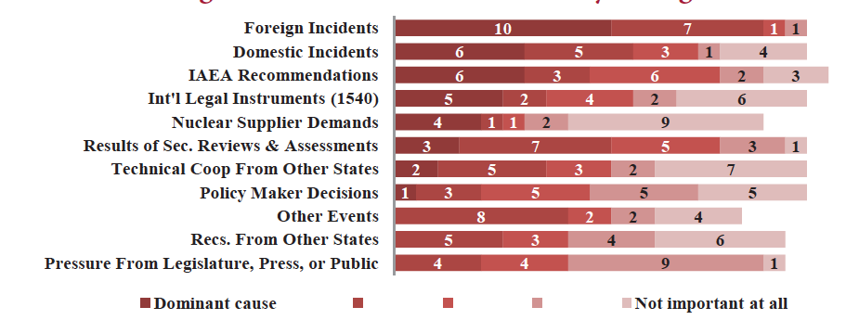
Drivers of nuclear security change
Source: Bunn and Harrell, Threat Perceptions and Drivers of Change in Nuclear Security Around the World: Results of a Survey (2014)

Slide 41
Nuclear security: an incident-driven punctuated equilibrium
Normal state:
  Regulators, operators believe existing security arrangements are sufficient, until there is overwhelming contrary evidence
Major incidents drive change – but how much varies
  Political, institutional, cultural factors affect how incidents are interpreted, responded to
  Does a near-miss mean “the system worked” or “we need to fix things so that doesn’t happen again”?
Policy-makers do not have to wait for incidents
  Poor results on inspections, failures in realistic tests can also be “incidents” that drive change
  International recommendations and reviews are influential
  In U.S. case, congressional investigations, embarrassing media stories, expert NGOs have played important roles

Slide 42
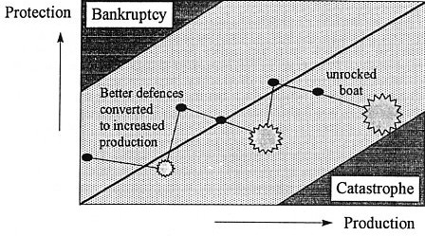
Navigating the punctuated equilibrium
From James Reason, Managing the Risks of Organizational Accidents (Ashgate, 1997)

Slide 43

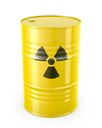
What affects nuclear security on the ground?
?
Rules & procedures
Resources
Training
Leadership
Threat perceptions
Vulnerability perceptions
Knowledge of best practices
Incentives
Organizational and national culture
International discussions and agreements affect these factors importantly, but indirectly

Slide 44
Demonstrated outsider threats
Large overt attack
  e.g., Moscow theater, October 2002: ~ 40 heavily armed, well-trained, suicidal terrorists, striking without warning
Multiple coordinated teams
  e.g., 9/11/01 -- 4 teams, 4-5 participants each, well-trained, suicidal, from group with access to heavy weapons and explosives, >1 year intelligence collection and planning, striking without warning
Significant covert attack
  e.g., Indian incident with thieves drilling through wall for sources
Use of unusual vehicles
  e.g., helicopters used in many recent jail escapes
  e.g., speedboat planned for use in $200M Millennium Dome theft

Slide 45
Demonstrated insider threats
Multiple insiders working together
Often including guards
  Most documented thefts of valuable items from guarded facilities involve insiders – guards among the most common insiders
  Goloskokov: guards “the most dangerous internal adversaries”
Motivations:
  Desperation
  Greed/bribery
  Ideological persuasion
  Blackmail
A trustworthy employee may not be trustworthy anymore if his family’s lives are at risk

Slide 46
Some tactics of concern
Deception
  Example: Thieves dressed as police arrive at Gardner Museum, walk off with priceless Rembrandts
  Example: Insider pulls alarm, “emergency, everybody out!” and carries material through emergency exit
Rapid barrier breaching or avoiding
  Example: throw a carpet over the razor wire in seconds
  Example: hand-carried explosives can blow through fences, vault doors, even (some) thick walls in seconds
  Example: tunneling into facility, or flying over barriers in helicopter, hang-glider, etc.
Conspiracy: multiple insiders, insiders+outsiders
  Hardest threats to defeat – insiders may include guards (41% of thefts from guarded facilities in one study), security experts

Slide 47
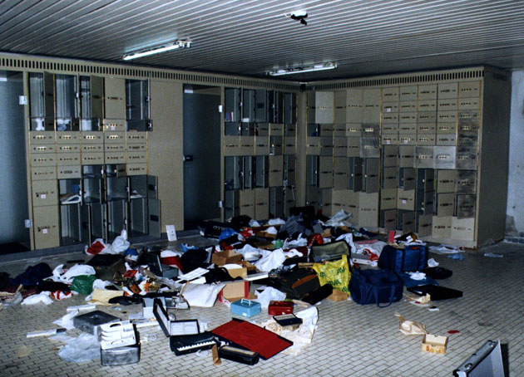
Antwerp Diamond Center heist, 2003
Source: Wired

Slide 48
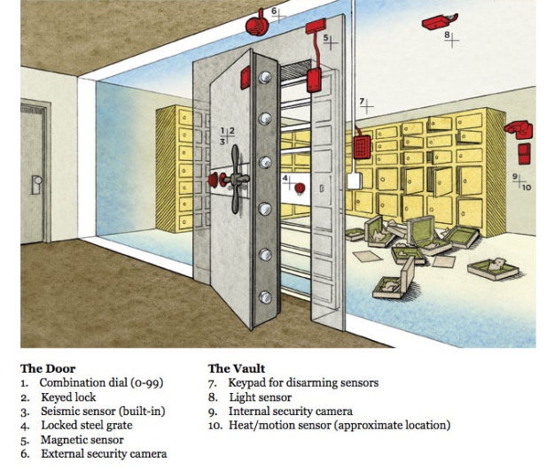
Antwerp Diamond Center heist
2003 (II)
Source: Wired

Slide 49
Importance of security culture
If employees don’t believe that the threat is real, they won’t devote much effort to security measures
If employees don’t believe the security rules are sensible and effective approaches to addressing the threat, they won’t follow them
If guards turn off alarms because they are annoyed by the false alarm rate, employees prop open security doors for convenience, and guards patrol without ammunition to avoid accidental firing, even excellent hardware will not provide good security
“Good security is 20% hardware and 80% culture.”
Strong security culture is hard to achieve (example: recent Y-12 intrusion)

Slide 50
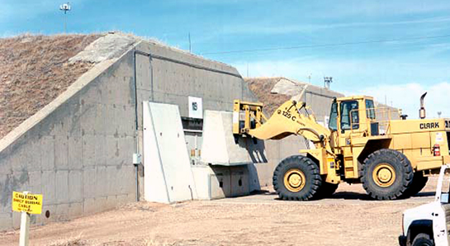
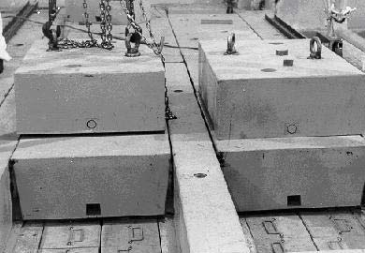
Security measures that minimize reliance on culture
Source: Department of Energy

Slide 51
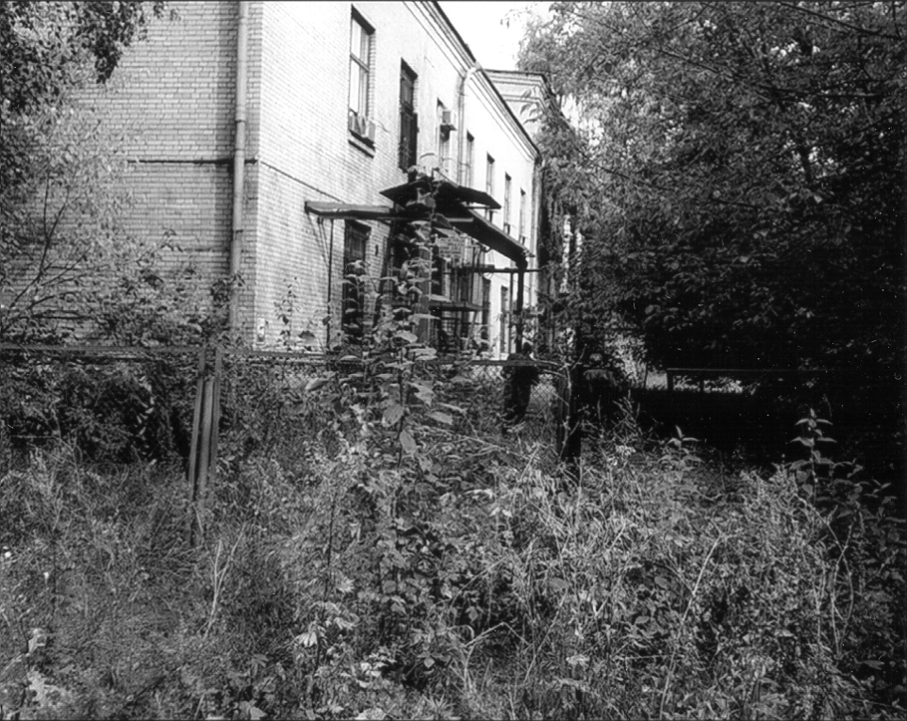
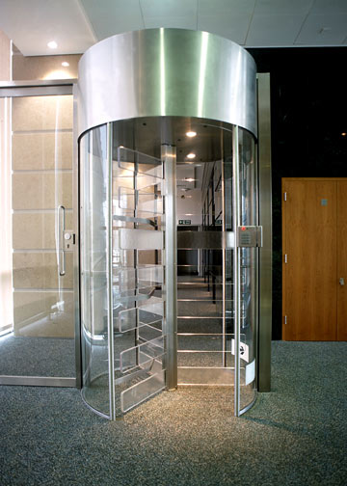
Does equipment influence culture?
Source: Department of Energy

Slide 52
How can national authorities influence facility-level security culture?
Very difficult to regulate the quality of security culture (or safety culture) – easier to regulate either:
  Objectively-measured performance
  Compliance with rules
National authorities could require (or encourage, and pay for) operating organizations to take particular steps
  Regular security culture assessments
  Programs to address identified weaknesses
  Could then review quality of each organizations’ culture programs, suggest implementation of good practices from other organizations
Other?

Slide 53
Protecting against the insider threat
Insider threats are the most important and challenging
  All nuclear material thefts where the circumstances are known perpetrated by insiders or with the help of insiders
Insider controls must combine several elements
  Control the insiders (personnel reliability programs, access control, searches/detectors on entry and exit…)
  Control the material (tags, seals, cameras, alarms, accurate near-real-time accounting)
  Control the interactions between the two (two-person rule, monitoring whenever people are near the material)
  Material accounting is fundamental – especially for stopping slow theft of bits at a time – but uncertainties make it difficult
  Kinds of accounting and control needed for security are not identical to those required for IAEA safeguards
See Bunn & Glynn, 2012, Bunn & Sagan (forthcoming)

Slide 54
Personnel screening and reliability
Access control has limited value unless effective screening of personnel is in place
Typical approach: background check before hiring (criminal record, terrorist links, financial status, comments from neighbors, co-workers, others)
Some organizations also use: polygraph (generally ineffective), psychological interviews (probably ditto)
Continuing checks after hiring also important:
  Drug and alcohol testing
  Monitoring of on-the-job performance, reporting of irregularities, suspicious activities
  Regular monitoring of, e.g., financial status
  Re-investigation every few years (e.g., every 5 years for U.S. “Q” [nuclear weapons information] clearance)

Slide 55
Example: new accounting and control system at Elektrostal
Major HEU and LEU fuel fabrication facility in Russia
  Site of multiple HEU thefts in 1990s
New pilot accounting and control system:
  Material enters area in sealed canister, accurately weighed
  Canister can only be opened by worker using his card and passcode – knows WHO opened the canister and WHEN
  Canister only opens into glovebox where work is to be done – which automatically weighs the material again
  Material can only be removed from glovebox into a similar canister, which can only be done using an electronic card and passcode – and it is then measured again
  Cameras observe the entire area at all times
  System knows where the material is, and who has access to it, in real time

Slide 56
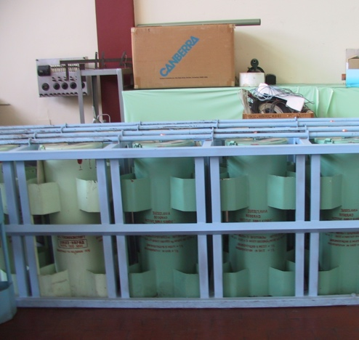
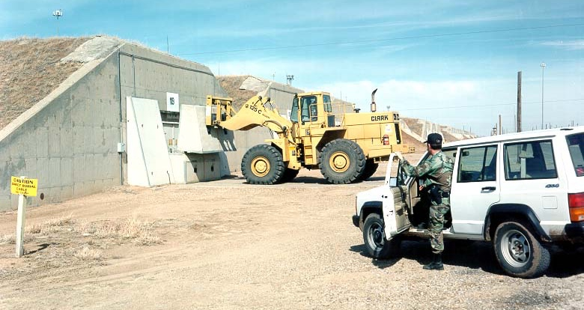
“Inherently secure” systems?
Examples: concrete blocks, steel cages
Less reliance on human factor, security culture
No need for continuing investments for sustainability
Only applicable for rarely used material
Only provide delay – not detection or defeat
Can be highly effective (and cheap) in concert with other system elements

Slide 57
Could terrorists cause a
“security Fukushima”?
Fukushima caused by inadequate preparation and an extraordinary natural disaster
Reaffirmed that a nuclear accident can cause extraordinary terror, disruption, and cost
Can be caused by destroying off-site power and backup generators, or destroying cooling system
Al Qaeda, Chechens, and other terrorist groups have considered sabotaging nuclear reactors
Source: Air Photo Service, Japan
Nuclear safety and security are closely linked – you can’t be safe without being secure.

Slide 58
Did you know? Real incidents related to nuclear terrorism
Events that have genuinely occurred:
  A large-scale terrorist attack on a U.S. nuclear weapons base
  Terrorist teams carrying out reconnaissance at Russian nuclear weapons storage facilities
  An attack on the Pelindaba site in S. Africa (100s of kgs of HEU) by two armed teams
    One team penetrated 10,000-volt security fence, disabled intrusion detectors, went to emergency control center, shot worker there
    45 minutes inside guarded perimeter, never engaged by site security forces
  A terrorist attack on a nuclear facility (not yet operational) in which armed guard force was overwhelmed, terrorists were in control of facility for an extended period
  More than a dozen real acts of sabotage at nuclear facilities
    None apparently intended to cause large radioactive release
    One involved firing a rocket-propelled grenade at a nuclear facility
  Russian businessman offering $750,000 for stolen weapon-grade plutonium, for sale to a foreign client

Slide 59
Did you know? Real incidents related to nuclear terrorism (II)
Events that have genuinely occurred:
  Preliminary explosive tests in al Qaeda’s nuclear program
  Repeated al Qaeda efforts to get stolen nuclear material or nuclear weapons (most recently in 2003)
  Repeated al Qaeda attempts to recruit nuclear expertise
    Including bin Laden and Zawahiri meeting with senior Pakistani scientists
  al Qaeda seeking and receiving religious ruling authorizing nuclear attack on American civilians (2003)
  Several incidents of al Qaeda considering (but not pursuing) attacks on nuclear power plants
Good news on nuclear terrorism (as far as we know):
  No convincing evidence terrorists have yet succeeded in getting either materials or expertise needed
  Risk has likely declined, because of improved nuclear security, large disruptions to “al Qaeda central”
  Both al Qaeda and Aum Shinrikyo found nuclear to be difficult

Slide 60
Issues for U.S. nuclear security
Y-12 incident reveals major security culture problem
  May be widespread in the U.S. complex
  Past problems with sleeping guards, etc.
  Inadequate attention to assessing, improving the “human factor” in security
NRC weakening some security rules
  Exempting reactors using plutonium-uranium mixed oxide (MOX) fuel from Category I security requirements – may exempt MOX fabrication plant as well
  Considering broader exemptions for plutonium mixed with uranium
  Threat facilities must protect against weaker than DOEs – even for facilities with tons of weapon-grade HEU metal
Inadequate attention to insider conspiracies
  Rules assume with personnel reliability program sites do not have to worry about multiple insiders working together
  Multiple insiders are common problem in other industries
Notes:
Modified 3rd sub-bullet on Russia

Slide 61
Issues for Russian nuclear security
Sustainability
  Government insists sites pay for security themselves – sites with little revenue (e.g., research reactors) may not be able to
Insider protection
  Rules don’t require tamper-indicating seals that would be very hard to beat, or accounting that could detect slow, “bit-by-bit” thefts
  Many facilities have emergency doors with no detector or alarm – often open in summer to allow a breeze
  Widespread corruption and theft of non-nuclear items
Regulation
  Regulations still weak in several areas; regulatory agency has limited staff and power
Guard forces for nuclear material
  Still heavy reliance on poorly paid and trained conscripts
Limited realistic testing of security system performance against intelligent adversaries looking for weak points
Notes:
Modified 3rd sub-bullet on Russia

Slide 62
Some recent anecdotes of insecurity
Russia: Gen-Major Victor Gaidukov, commander of a nuclear weapon storage site, arrested for accepting >$300,000 in bribes (2011)
Pakistan: Brig.-Gen. Ali Khan arrested for ties to Islamic extremists (2011)
S. Africa: Two armed teams attack Pelindaba site where 100s of kilograms of HEU is stored, one penetrates 10,000 volt fence, disables intrusion detectors, shoots worker in emergency control center – never caught (2007)
Belgium: Peace activists break into nuclear weapon storage base, spend >1 hour there before being detected and stopped (2010)
United States: Bomber flies across the country with 6 nuclear weapons on board, no one knows – checks failed (2007)
Notes:
Modified next-to-last sub-bullet

Slide 63
Attack at Pelindaba, Nov. 8, 2007
Site with 100s of kgs of highly enriched uranium (HEU)
Attack by 2 teams of armed, well-trained men, from opposite sides
One team:
  Penetrated 10,000-volt security fence
  Disabled intrusion detectors
  Went to emergency control center, shot a worker there, who raised first alarm
  Spent 45 minutes inside guarded perimeter – never engaged by site security forces
  Left through same spot in fence – never caught or identified
South Africa has since undertaken major nuclear security upgrades, establishing regulatory design basis threat

