Slide 1

Confronting today’s nuclear challenges
Managing the Atom Project
Matthew Bunn
Professor of Practice, Harvard Kennedy School
April 9, 2020
scholar.harvard.edu/matthew_bunn
belfercenter.org/mta

Slide 2
A peril and a promise…

Slide 3
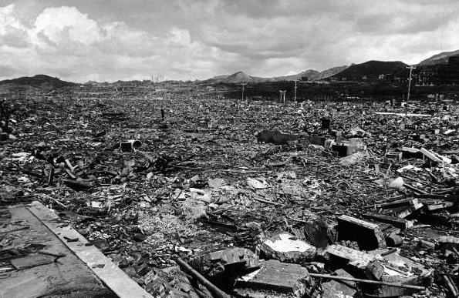
Effect of a single nuclear weapon
Source: Time-Life

Slide 4
Dateline: Russia
Aggressive nuclear modernization, exercises, rhetoric; arms control violations; cyberattacks; disinformation…
Heightened U.S.-Russian tensions – Ukraine, elections, NATO expansion, other issues
  Potential for conflict, e.g., in Baltics
Russian forces, command and control vulnerable; arms control in crisis; potential for launch on false alarm or unintended crisis escalation
Source: ITAR-TASS

Slide 5
Dateline: Russia
Nuclear arms control potentially collapsing
  INF Treaty is over
  New START expires early 2021, unless extended
  No talks on new agreement underway
Formal talks almost frozen
  Limited “strategic stability” talks
  Limited trade largely frozen by sanctions
  Very little mil-mil, legislator-legislator, scientist-to-scientist contact
Sarmat ICBM. Source: Natalia Kolesnikova/AFP/Getty

Slide 6
Dateline: China
Much smaller nuclear force, but major modernization underway
U.S.-China tensions – trade, IPR theft, South and East China seas, cyber, other issues
No arms control, verification, dialogue on strategic issues in place
  China (and Russia) concerned over U.S. missile defenses, conventional strike capabilities, nuclear modernization
Source: ITAR-TASS

Slide 7
Dateline: North Korea
Unpredictable dictator armed with ~25-60 nuclear weapons, ballistic missiles
  Has threatened to rain “nuclear fire” on ROK, Japan, United States
No nuclear or ICBM testing, but HEU, Pu production unabated
History of provocations against ROK – could lead to conflict
Agreements, sanctions, threats have all failed
No clear prospects for “denuclearization”
Source: KCNA
Notes:
WT

Slide 8
Dateline: North Korea (II)
Key dangers
  Nuclear use – e.g., DPRK might use in conflict, under “use them or lose them” pressure or to scare off its enemies
  Nuclear transfer -- to other states (e.g., al Kibar reactor in Syria), less likely to terrorist groups
  Pressures on others in region to match DPRK capability
  “Loose nukes” if regime collapses
Options
  Squeeze until DPRK collapses or capitulates (How feasible?)
  Seek to negotiate at least an interim freeze and no-transfer pact (What price? What risk reduction?)
  Military action (What risks? What could realistically be struck?)
  Do nothing (What risks?)

Slide 9
Dateline: Iran
Nuclear agreement reduced risk (if all sides complied)
But key restraints would have ended 8, 10, or 15 years later
Iran continues to support terrorist groups, undermine countries in the region, threaten Israel, test longer-range ballistic missiles – and has never given an honest declaration of its past nuclear weapons efforts
Where are we headed after U.S. withdrawal?
Source: khamenei.ir
Notes:
Verification still being implemented
Modest departures from enrichment restraints (except large growth in LEU)
But deal hanging by a thread

Slide 10
Dateline: Iran (II)
Key dangers
  Nuclear proliferation – Iran closer to the bomb today than when President Trump took office, developing more advanced (and easier to hide) centrifuges…
  Pressures on others in region to try to match Iran’s capabilities
Options
  Build more cooperative relationship? (How feasible? What risks?)
  Contain and deter, strengthen allies? (What risks and costs?)
  Seek to convince Iran it is not in its interest to greatly expand its nuclear capabilities? (How feasible?)
  Maintain, strengthen, sanctions regime? (What risks? What benefits?)
  Military action? (How plausible? What risks? What benefits?)
  Do nothing? (What risks?)

Slide 11
Dateline: South Asia
Ongoing nuclear arms race between Pakistan and India – who have fought 4 wars
Military doctrines with unclear redlines; terrorists might provoke conflict; could lead to blundering into war
Pakistan has world’s fastest-growing nuclear arsenal, and some of the world’s most capable terrorists
Some modeling suggests even Indo-Pakistani nuclear war could cause “nuclear fall”
Source: Wikimedia Commons
Notes:
WT

Slide 12
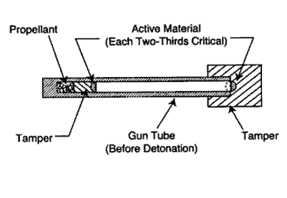
Dateline: Unknown
Nuclear and Radiological Terrorism
Numerous gov’t studies: terrorist group could plausibly make a crude bomb if it got material
~20 cases of seizure of stolen HEU or plutonium
Aum Shinrikyo, al Qaeda both pursued nuclear weapons
ISIS intent unclear, but still has more money, people, territory under control, ability to recruit globally than al Qaeda
Source: NATO

Slide 13
Dateline: Unknown
Nuclear and Radiological Terrorism (II)
Terrorists could also sabotage nuclear facilities (potentially cause Fukushima-scale accident), use radioactive material in “dirty bomb”
Options
  Improve security for nuclear and radiological materials, facilities (How to sustain momentum with the summit process years in the past?)
  Block nuclear smuggling (How to find the needles in the haystacks?)
  Counter high-capability terrorist groups (How can we do better?)
  Prepare to respond (How much can this mitigate the harm?)

Slide 14
Dateline: United States
Strategic modernization
U.S. strategic weapons are aging
Obama administration laid out a plan for new ICBMs, SLBMs, submarines, bombers, and cruise missiles, with “life extended” (upgraded) warheads
Trump endorsed, expanded with new low-yield SLBM, nuclear SLCM, new warhead
>$1 trillion cost over 30 years
Likely to be unsustainable in the face of conventional needs, other priorities
Need broader debate over deterrence needs, costs, risks, arms control
Source: DOD

Slide 15
Dateline: Global
Strengthening the global regime
Many states unhappy with Nonproliferation Treaty – failed treaty review in 2015, 2020 review postponed
Ongoing challenges controlling sensitive technologies – new tech. such as additive manufacturing makes more difficult
Possible spread of ostensibly civilian enrichment and reprocessing as nuclear energy grows and spreads – steps needed to reduce risks
Source: AFP

Slide 16
Dateline: Global
Strengthening the global regime (II)
Non-nuclear states negotiated nuclear weapons ban
  Nuclear-armed states have no interest, but treaty will be fixture of international scene for decades to come
States threatened by powerful neighbors or major powers may still seek nuclear weapons – or “hedging” capability that would allow them to build weapons quickly
  Much to do to reduce “demand” for nuclear weapons, especially in Middle East and East Asia
Lack of arms control progress means more political tension in nonproliferation regime
  Little near-term prospect for bringing Comprehensive Test Ban Treaty into force or negotiating fissile cutoff
  Little near-term prospect of real progress toward Middle East Weapons of Mass Destruction Free Zone
  All nuclear powers modernizing their forces

Slide 17
Nuclear weapons: some good news
Global nuclear weapons stockpiles down ~85%
Only 9 states with nuclear weapons – same as 30 years ago
More states have started nuclear weapons programs and given them up than have nuclear weapons – our efforts to stop programs succeed more often than they fail
>50% of the states that once had potential nuclear bomb material on their soil have eliminated it
Nuclear material around the world far more secure than it was 25 years ago

Slide 18
The importance of presidential judgment
Cuban Missile Crisis:
  Initially, Kennedy’s advisors called for air strikes followed by an invasion
  Kennedy pushed back, asking for another option
  The recommended course might well have led to nuclear war
Kennedy: Key lesson was always to offer the adversary a face-saving way to back down
The world relies on sober judgment by the leaders of nuclear states
Source: JFK Library

Slide 19
Backup slides if needed…
Notes:
MB – after this slide but before the next, do risk-informed approach discussion

Slide 20
Dateline: Global
Chemical and biological threats
Widespread chemical use by Syria – even after alleged disarmament
  Chemicals not covered by dismantlement (e.g., chlorine)
  Evidence Syria violated pact, kept and used some nerve gas
North Korea and Russia apparently used chemical weapons for assassinations—may indicate other stocks
Terrorists have pursued chemical, biological weapons
  ISIS produced, used its own mustard gas
  Aum Shinrikyo conducted nerve gas attacks in Tokyo subways
  Aum Shinrikyo, al Qaeda pursued anthrax, other biological agents
  New gene editing technology (e.g., CRISPR) could increase risks
Some state biological weapons programs may persist
Deep dual-use dilemmas, verification challenges
Notes:
MB – after this slide but before the next, do risk-informed approach discussion

Slide 21

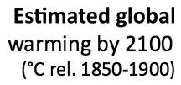
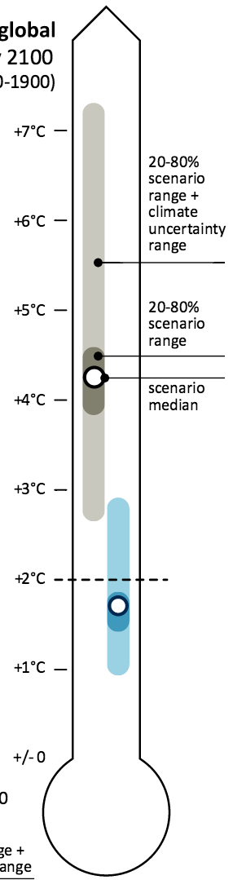
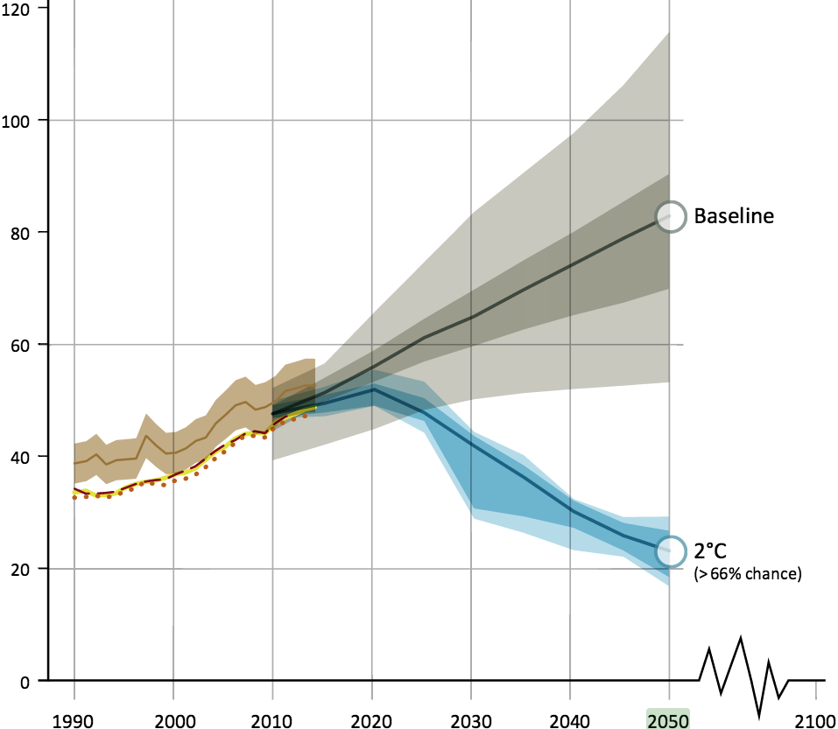
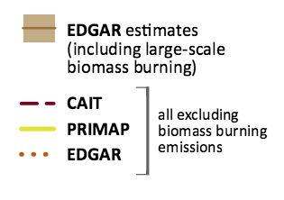
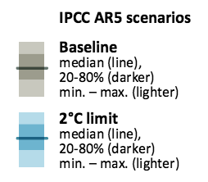
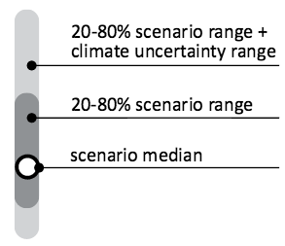
Huge, transformational nuclear growth needed for substantial climate role
Carbon displaced by the IAEA high nuclear growth case
}

Slide 22
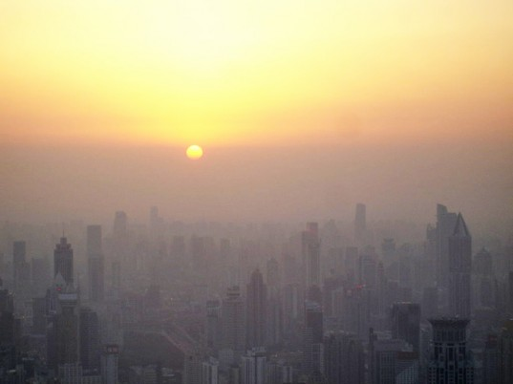
Particulates may be even more important than climate in driving clean energy
Smog in Beijing. Source: inhabitat.com
>3 million deaths/yr globally from fine particulates

Slide 23
Key constraints on large-scale nuclear energy growth – can they be loosened?
Economics
Safety risks – real and perceived
Security risks – real and perceived
Nuclear waste management – mostly politics
Siting and public acceptance
Limited government and industry capacity
Stringent regulation
Proliferation risks – mainly from the nuclear fuel cycle
U supply: Not likely to be a constraint this century
In each area, both new policies and new technologies have the potential to loosen past constraints on growth

Slide 24
Maintaining U.S. nuclear influence
U.S. role in the nuclear market is now greatly reduced
But the United States offers world-leading innovation, and approaches to safety, security, and nonproliferation
Both economic and security benefits to maintaining a significant U.S. position in nuclear markets
  Important to U.S. influence over other countries’ nuclear choices
Next president will have to grapple with:
  How to avoid losing nuclear’s domestic low-carbon contribution
  How to ease the path to commercializing new technologies
  How to help U.S. firms compete against state-owned (or assisted) firms from other countries
  How best to advance U.S. nuclear safety, security, nonproliferation objectives

